Slide 1
Нейронные сети
Sequence to sequence

Slide 2
Занятие 5
Seq2seq
Concept
Training
Inference
Attention
Architectures with Attention
Transformer
Self-Attention
Positional Encoding
FNNet
BERT

Slide 3
Concept
1

Slide 4
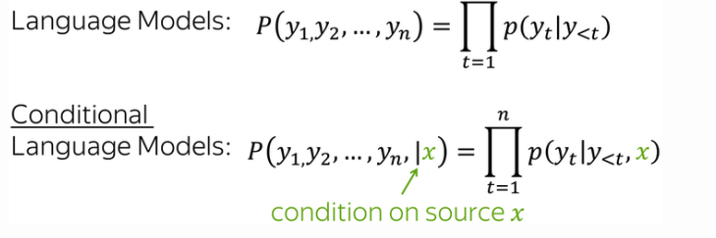
Concept
https://lena-voita.github.io/nlp_course/seq2seq_and_attention.html

Slide 5
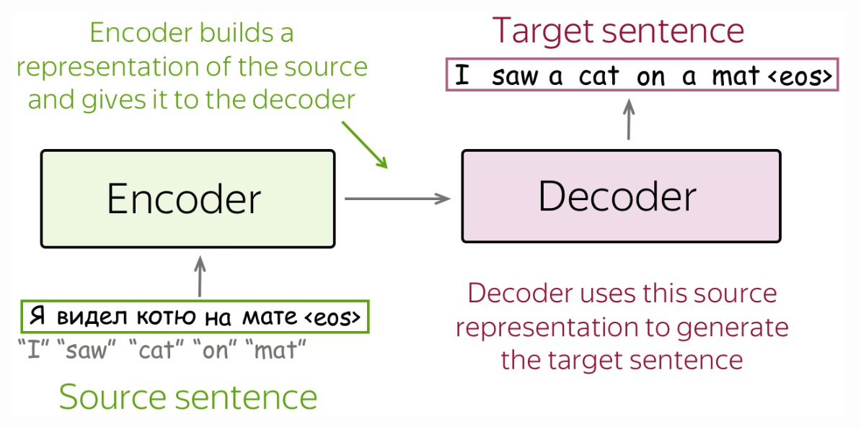
Concept

Slide 6
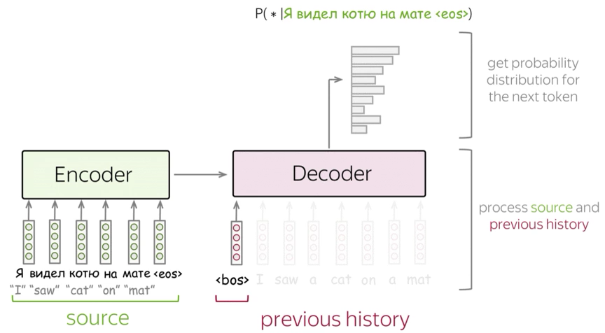
Concept

Slide 7
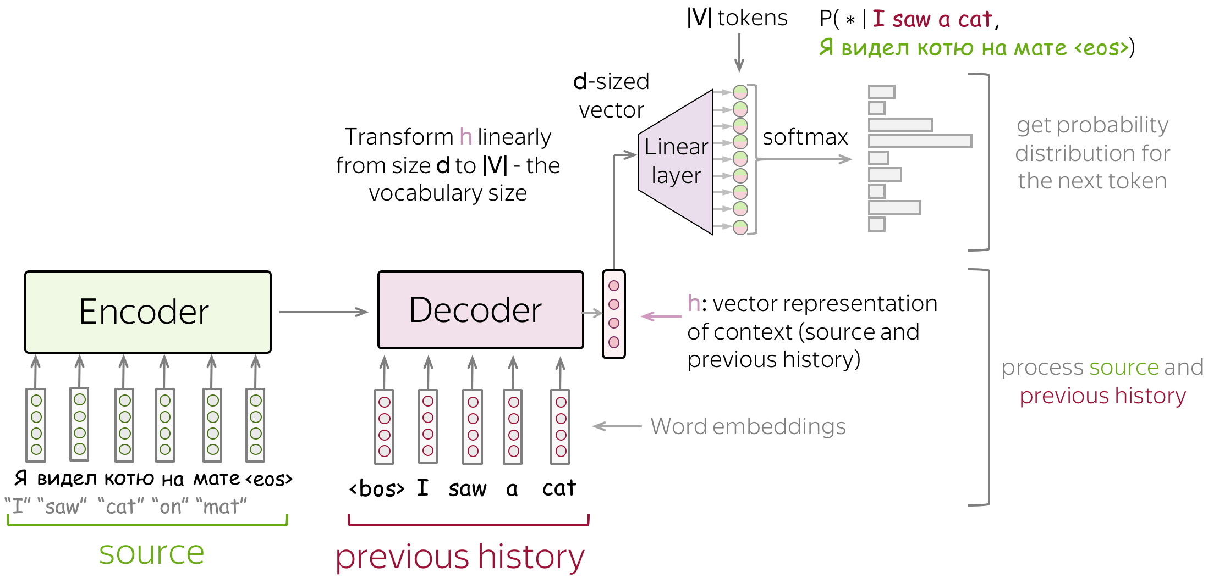
Concept

Slide 8
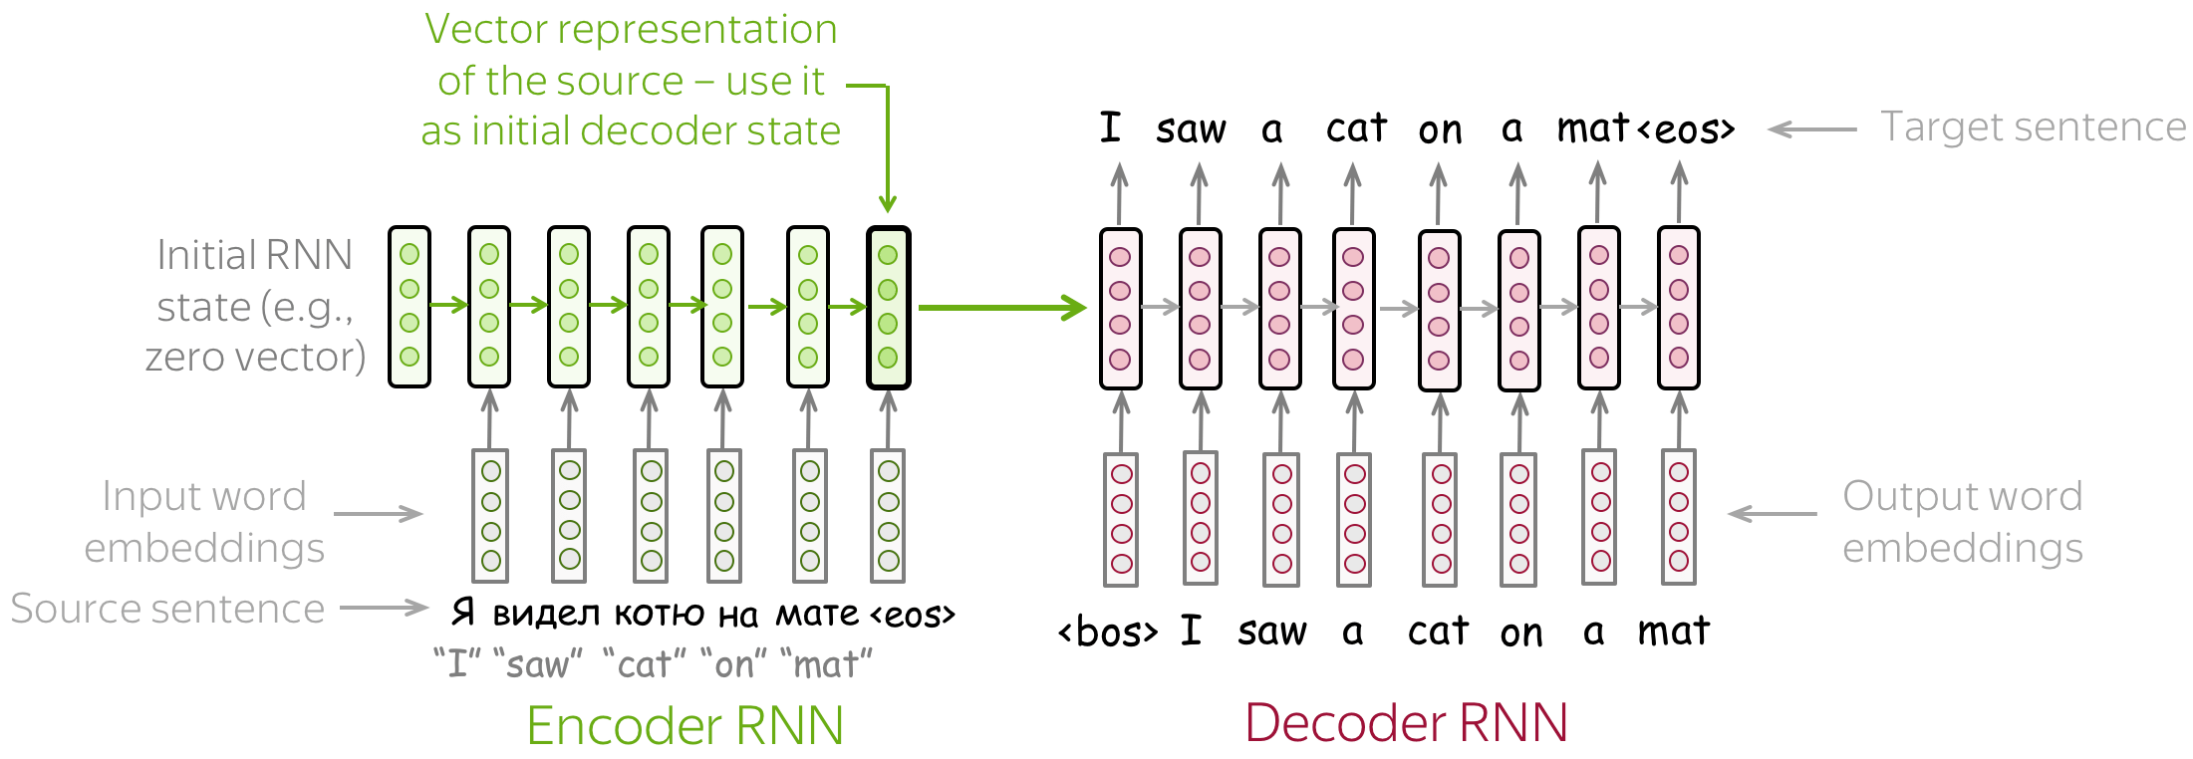
Seq2seq RNN

Slide 9
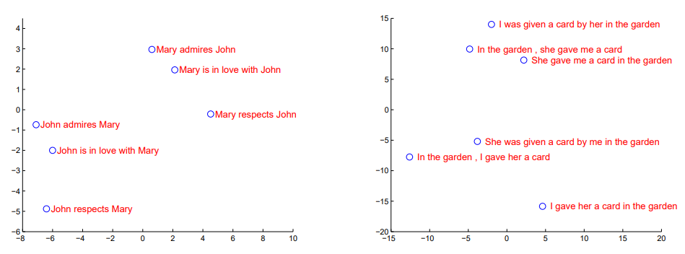
Seq2seq RNN
2dim PCA
https://arxiv.org/pdf/1409.3215.pdf

Slide 10
Training
1

Slide 11
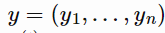
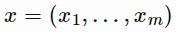
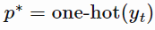
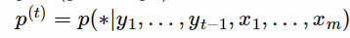
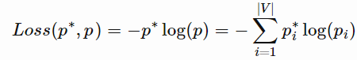
Training
target
source sequence
target distribution
predicted distribution

Slide 12
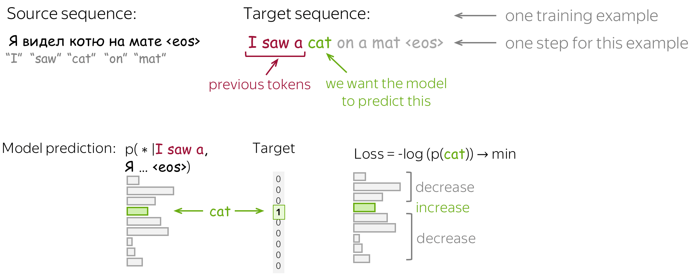
Training

Slide 13
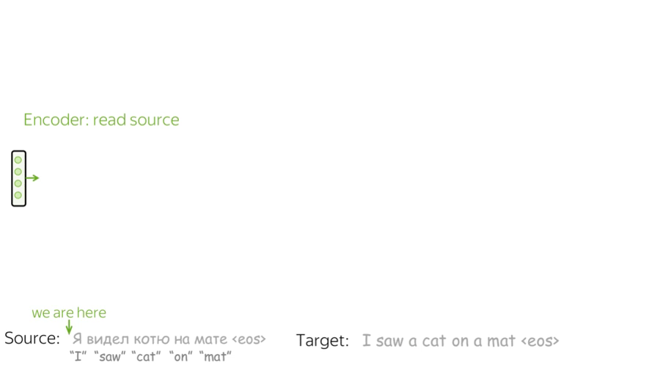
Training

Slide 14
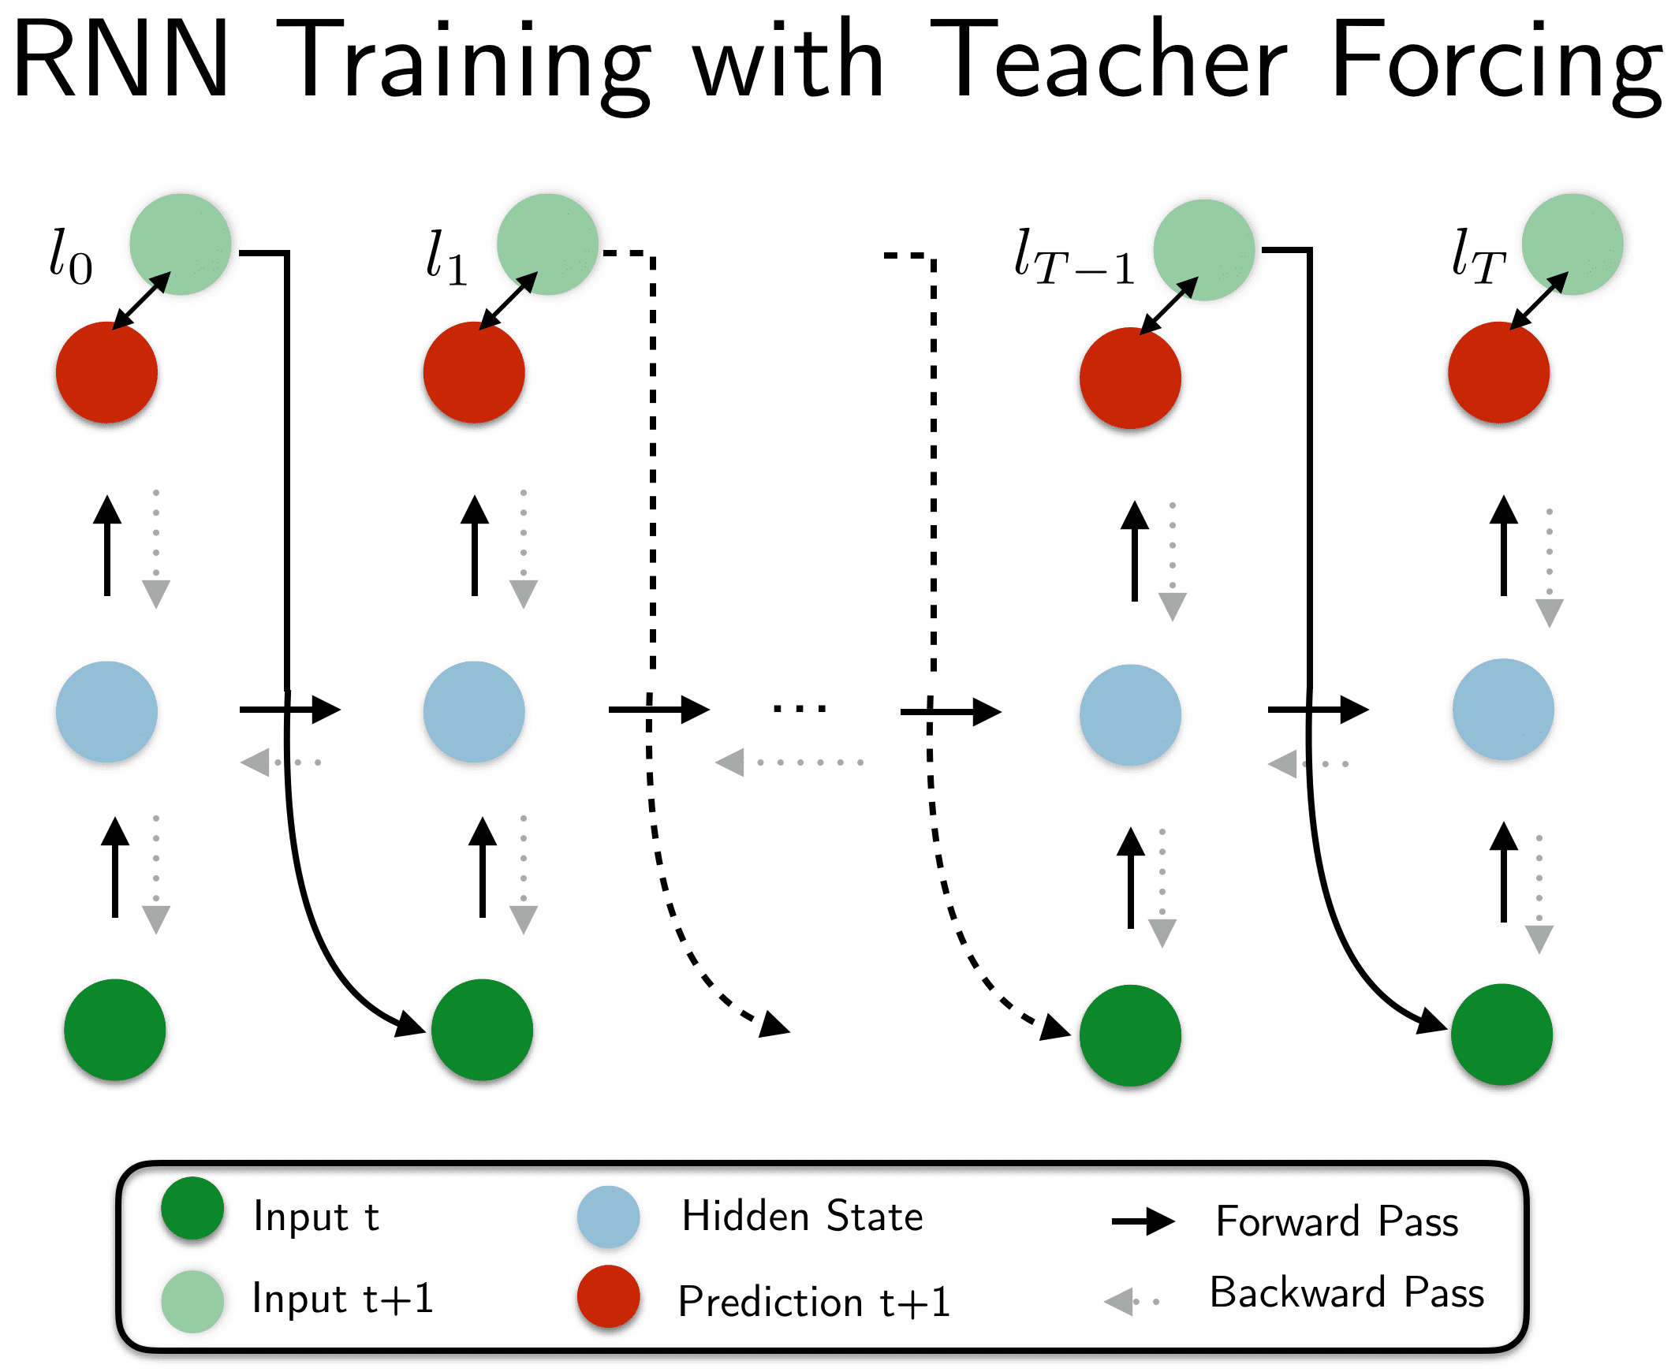
Training

Slide 15
Inference
1

Slide 16
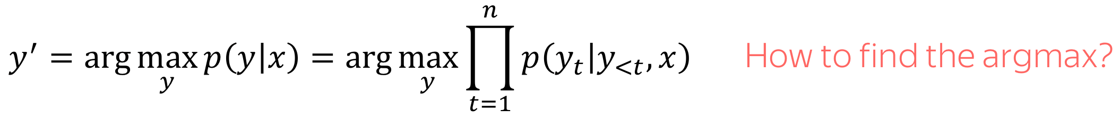
Inference

Slide 17
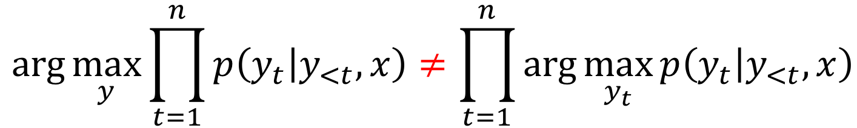
Greedy decoding
Generate most probably token on each step

Slide 18
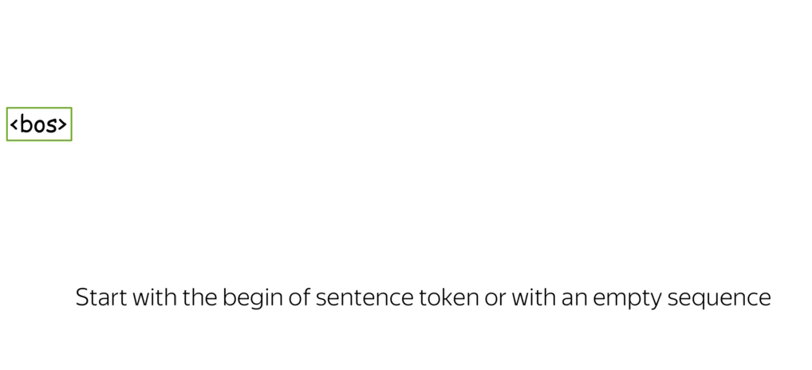
Beam search
Get top N hyptotheses on each step

Slide 19
Attention
1

Slide 20
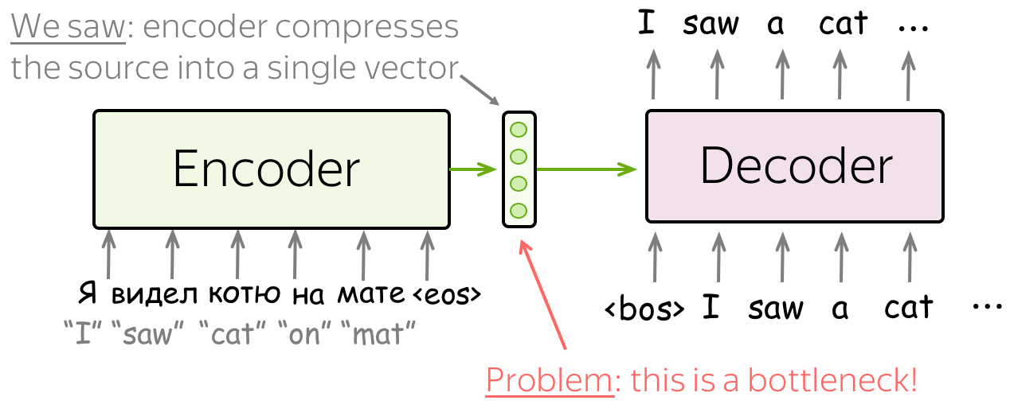
Attention

Slide 21
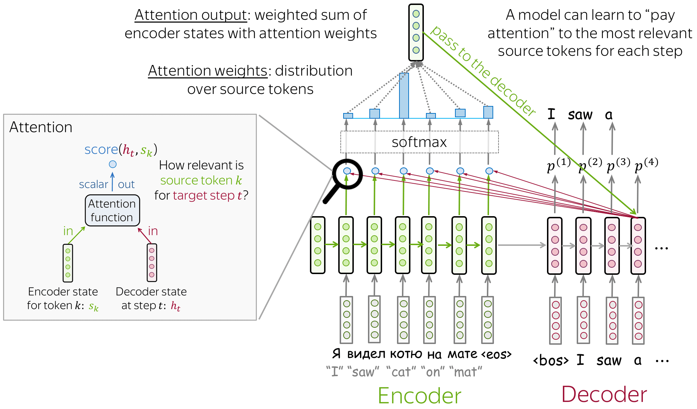
Attention

Slide 22
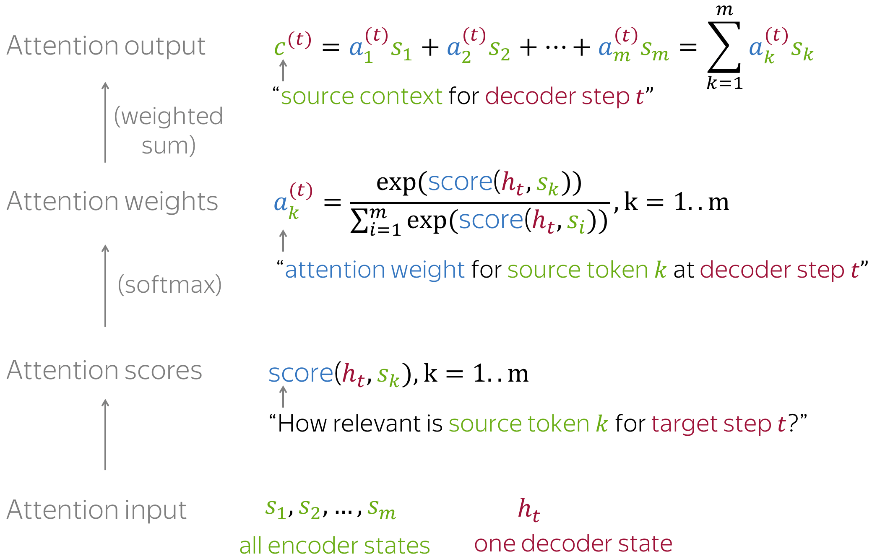
Attention

Slide 23
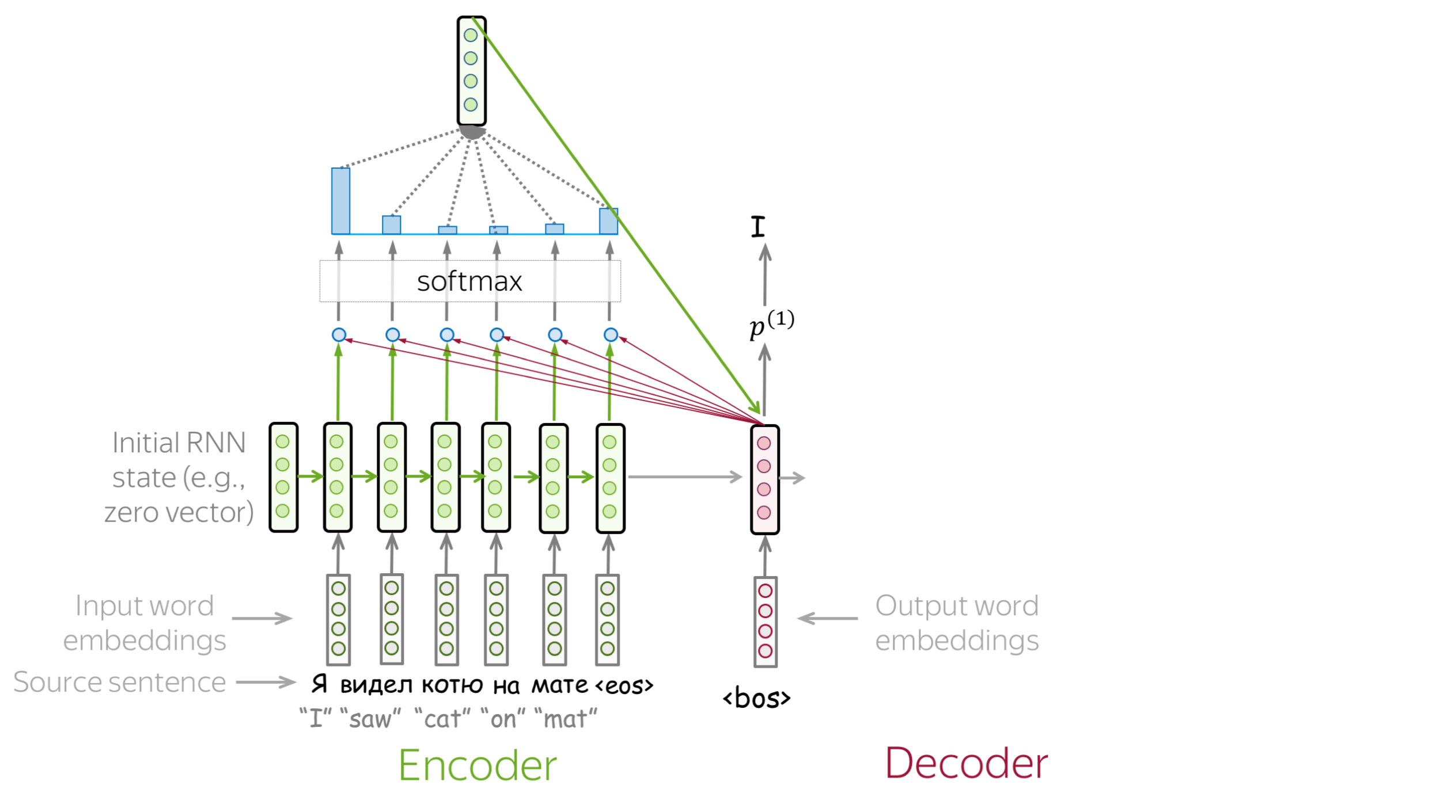
Attention

Slide 24
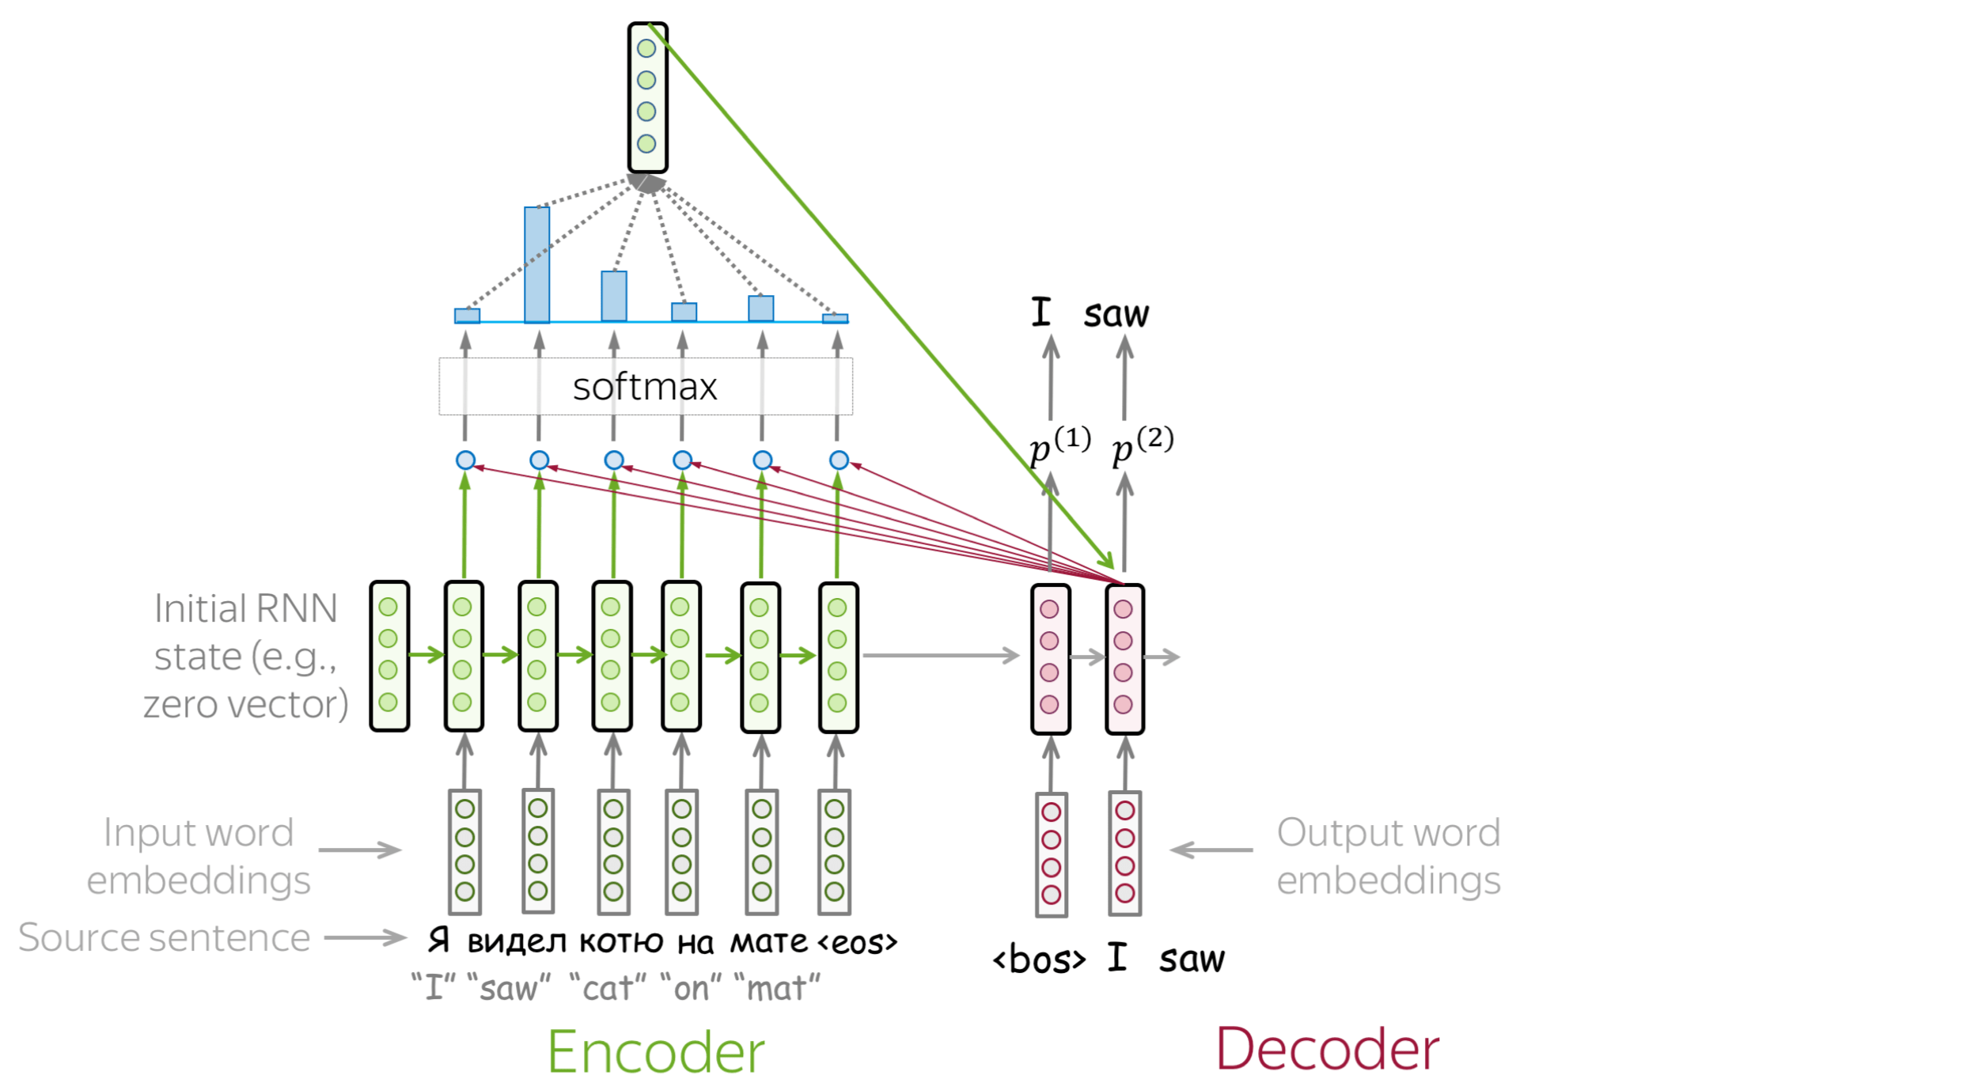
Attention

Slide 25
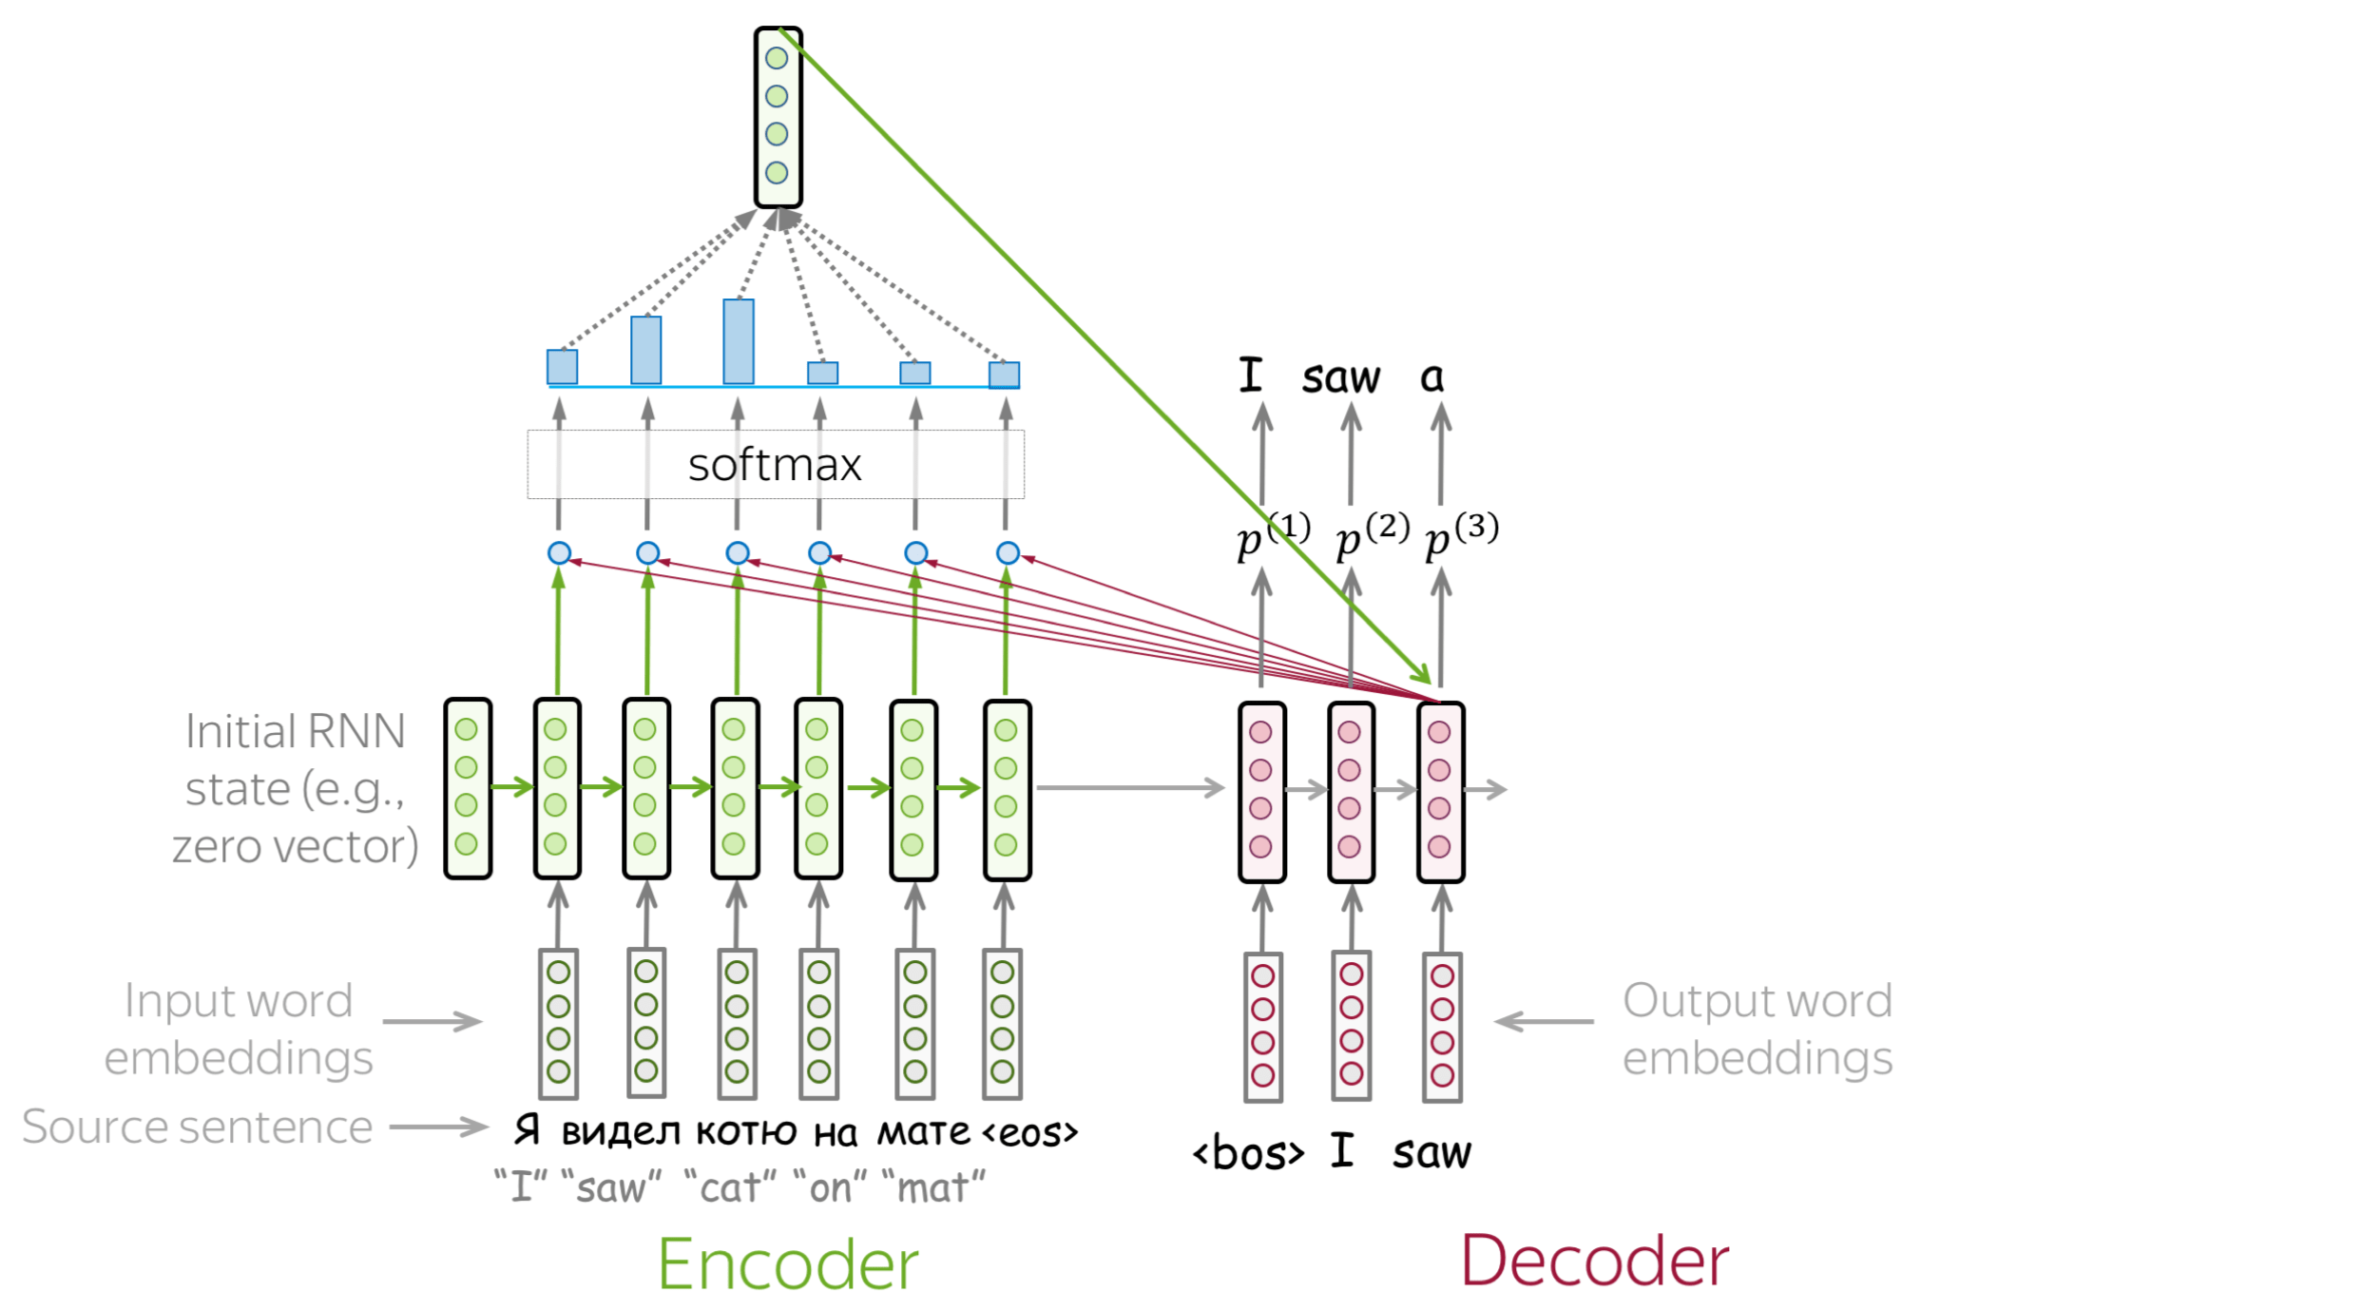
Attention

Slide 26
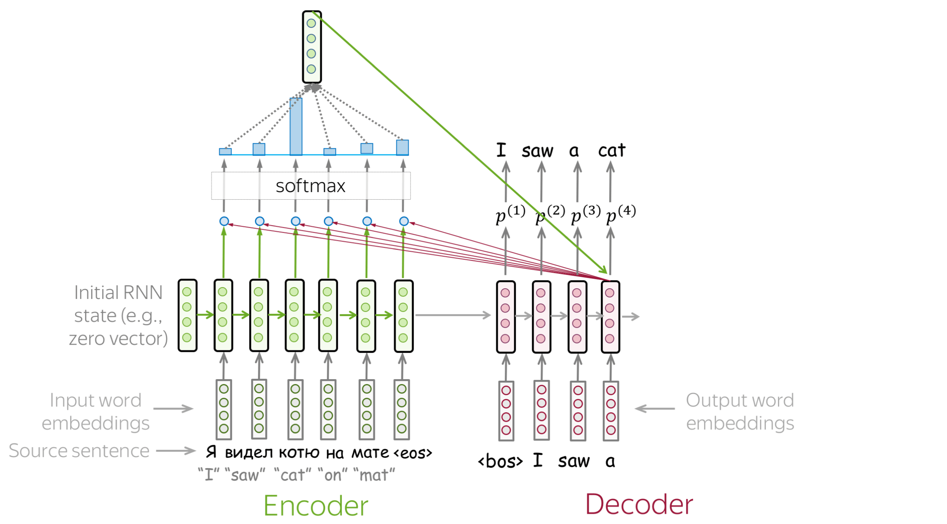
Attention

Slide 27
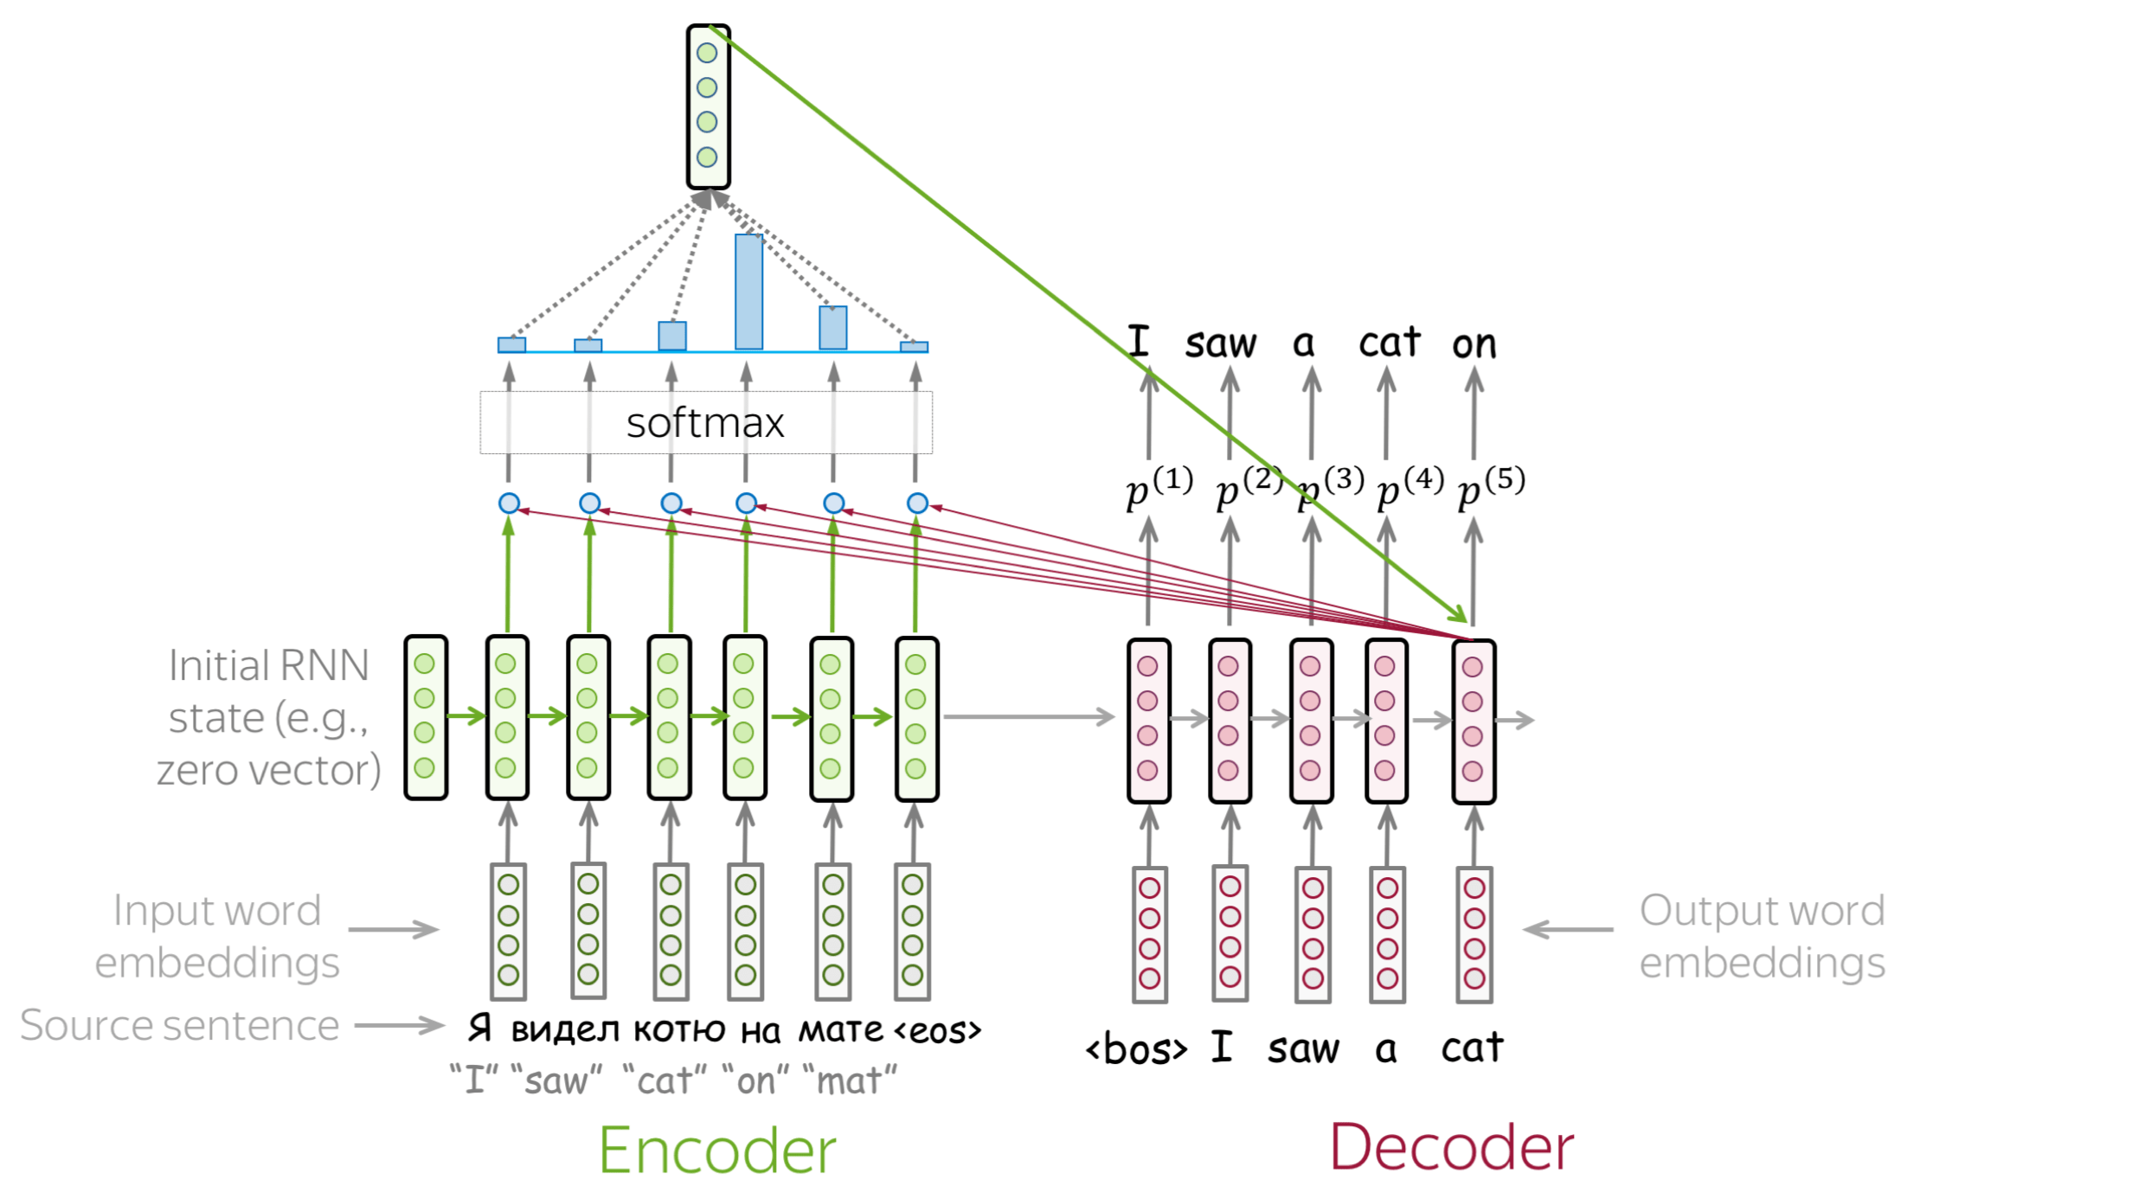
Attention

Slide 28
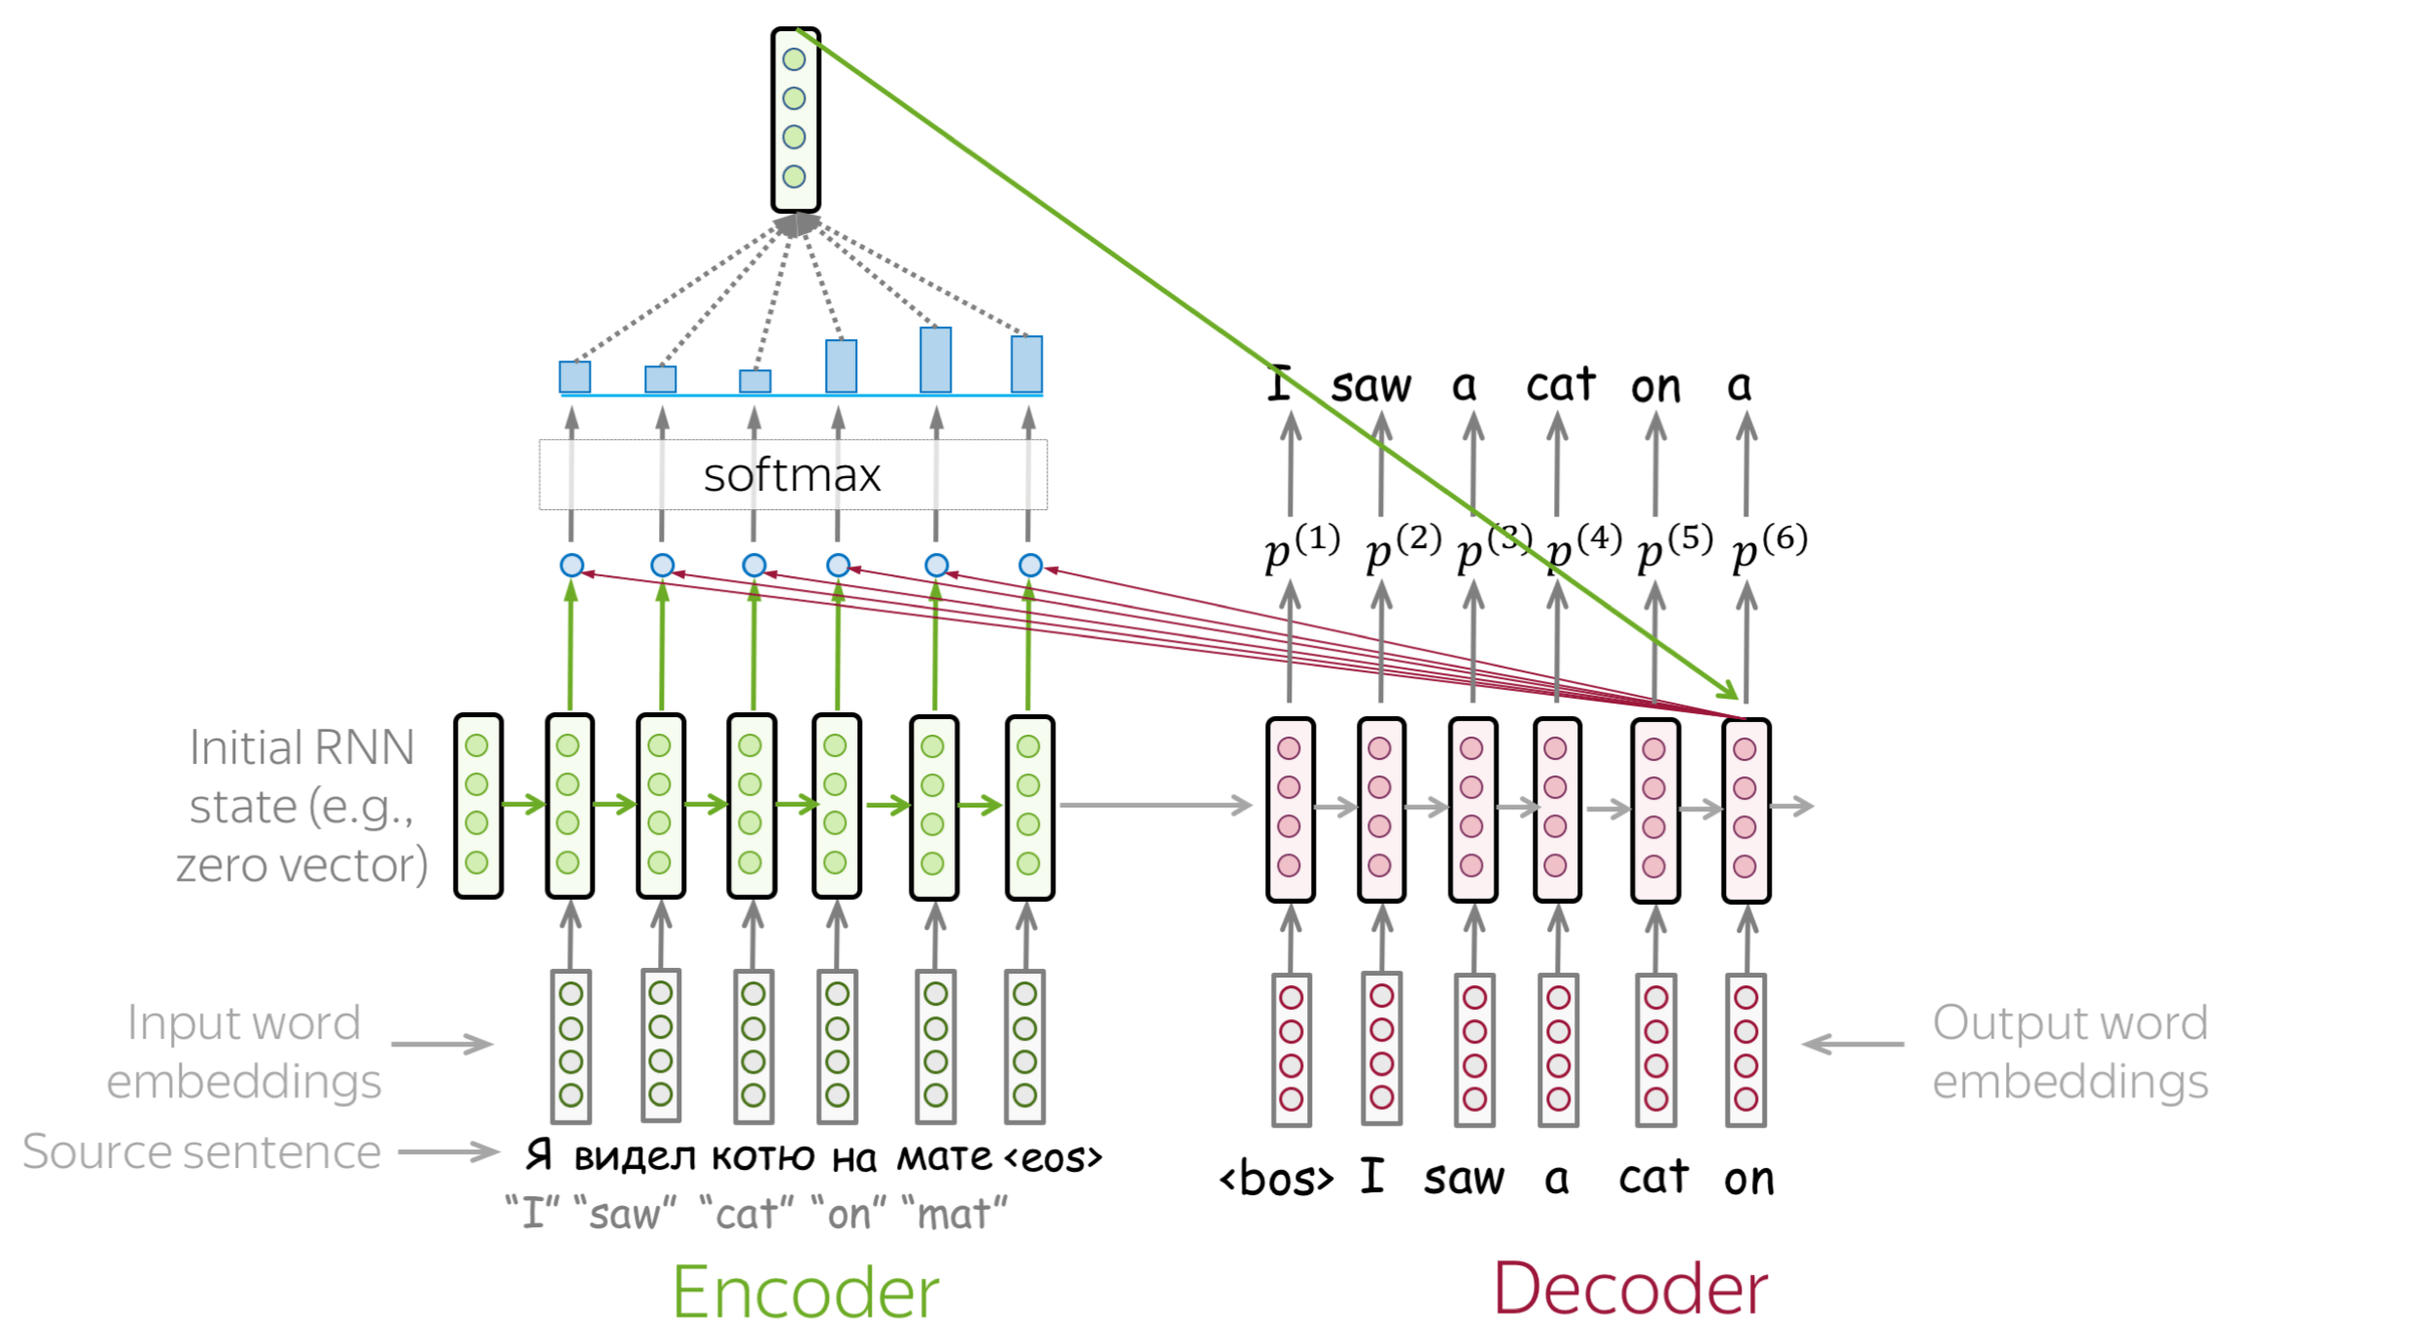
Attention

Slide 29
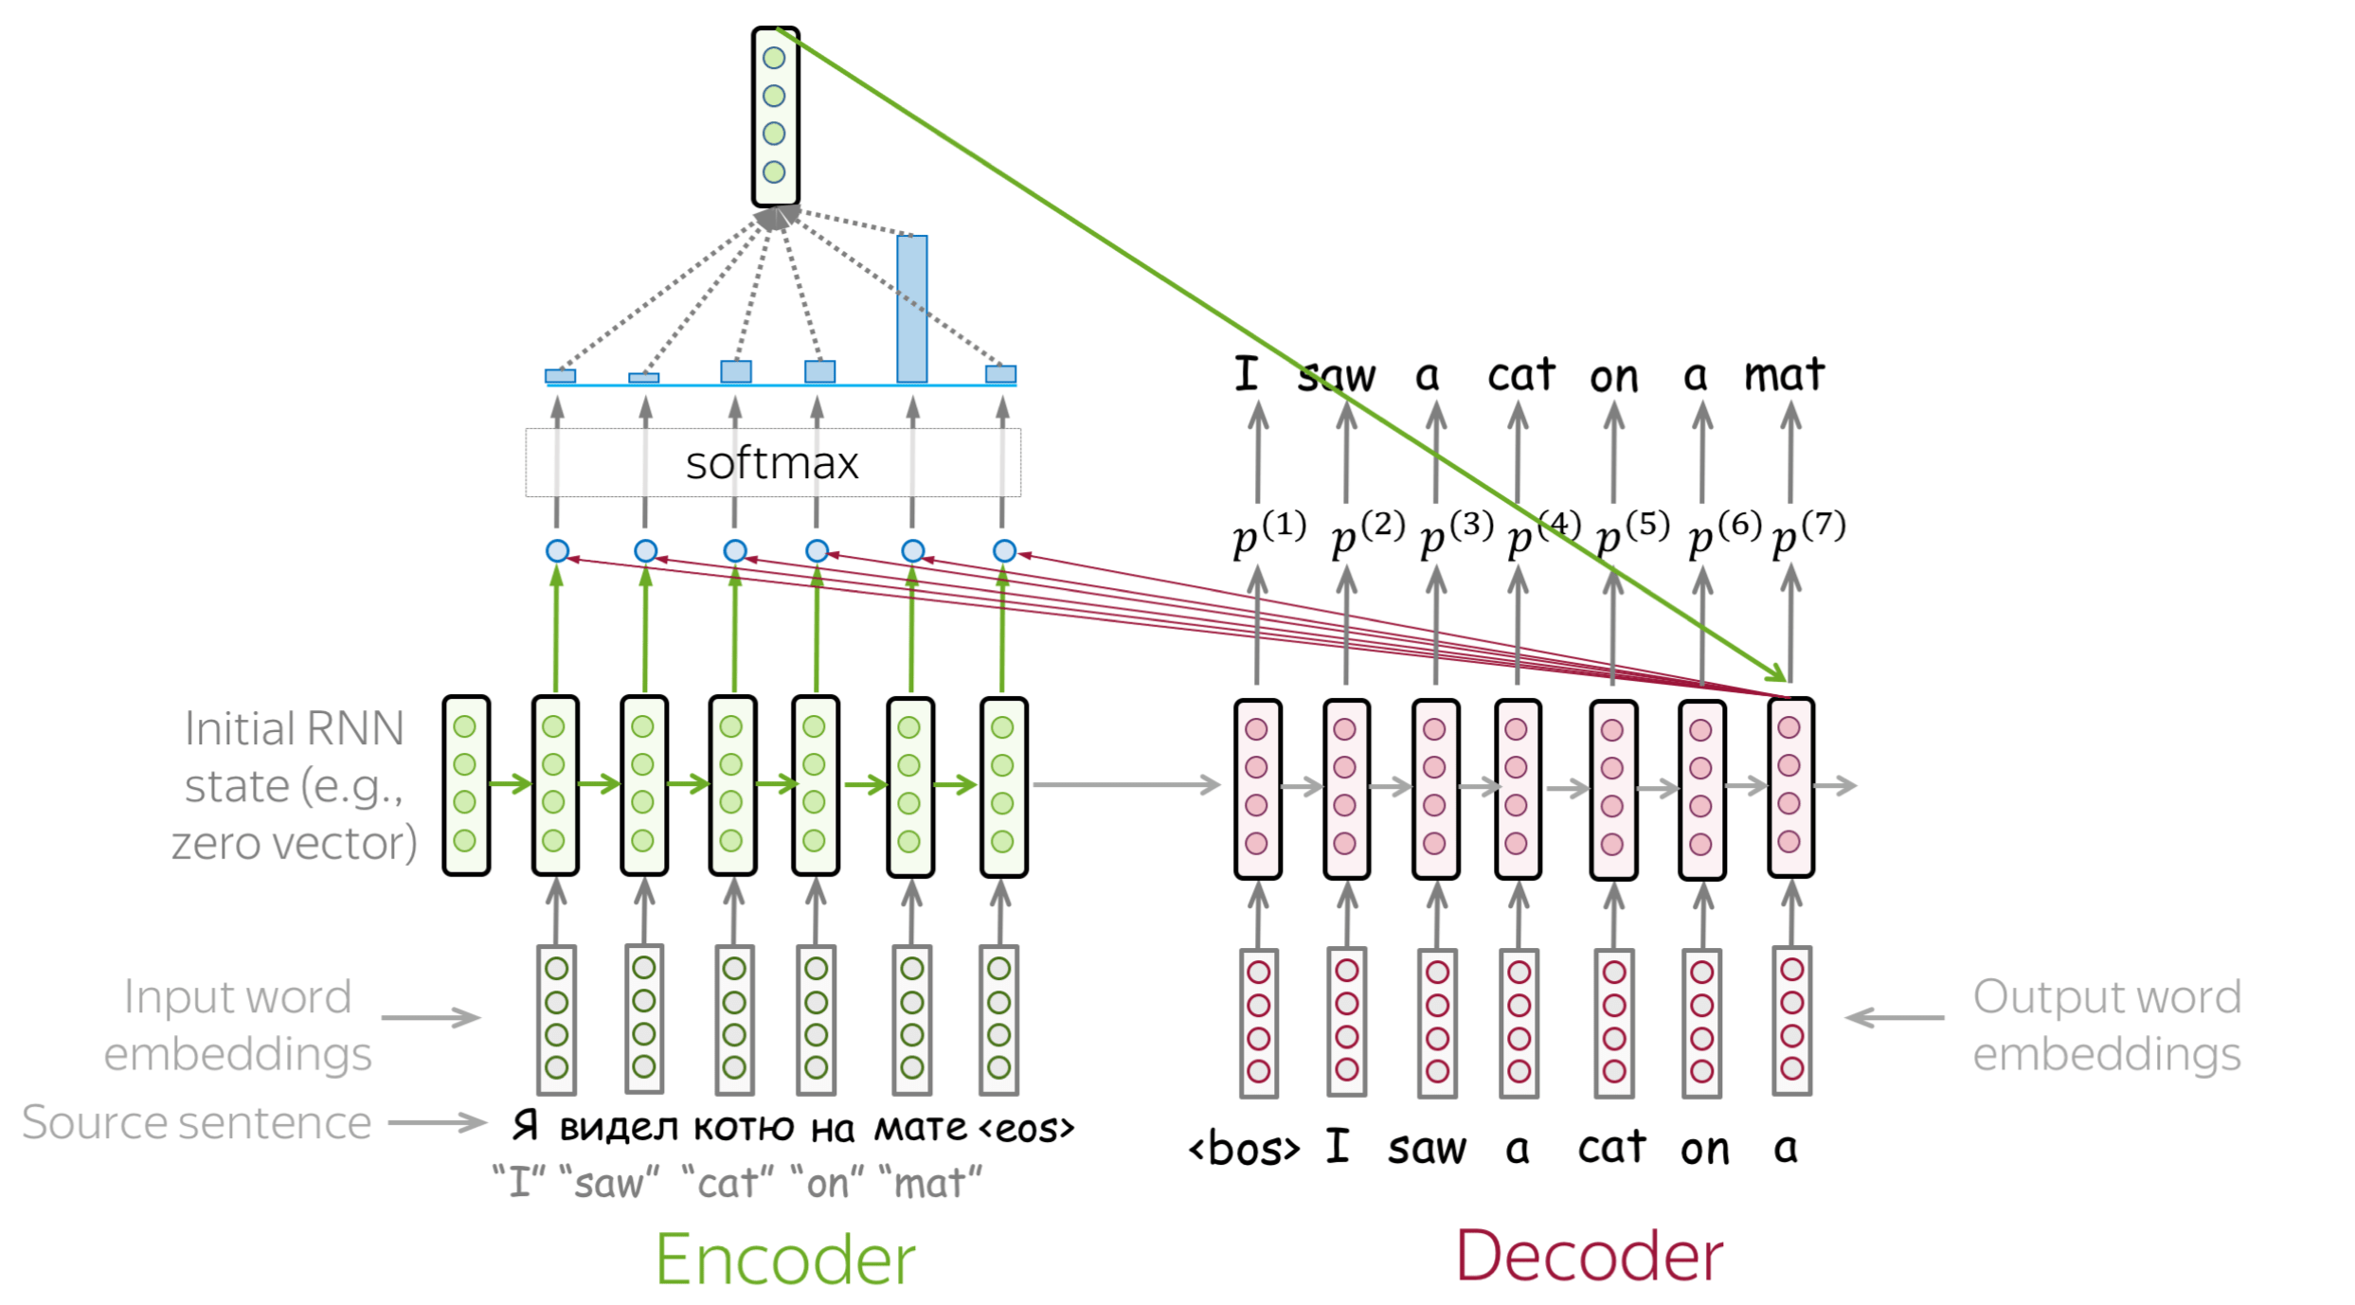
Attention

Slide 30
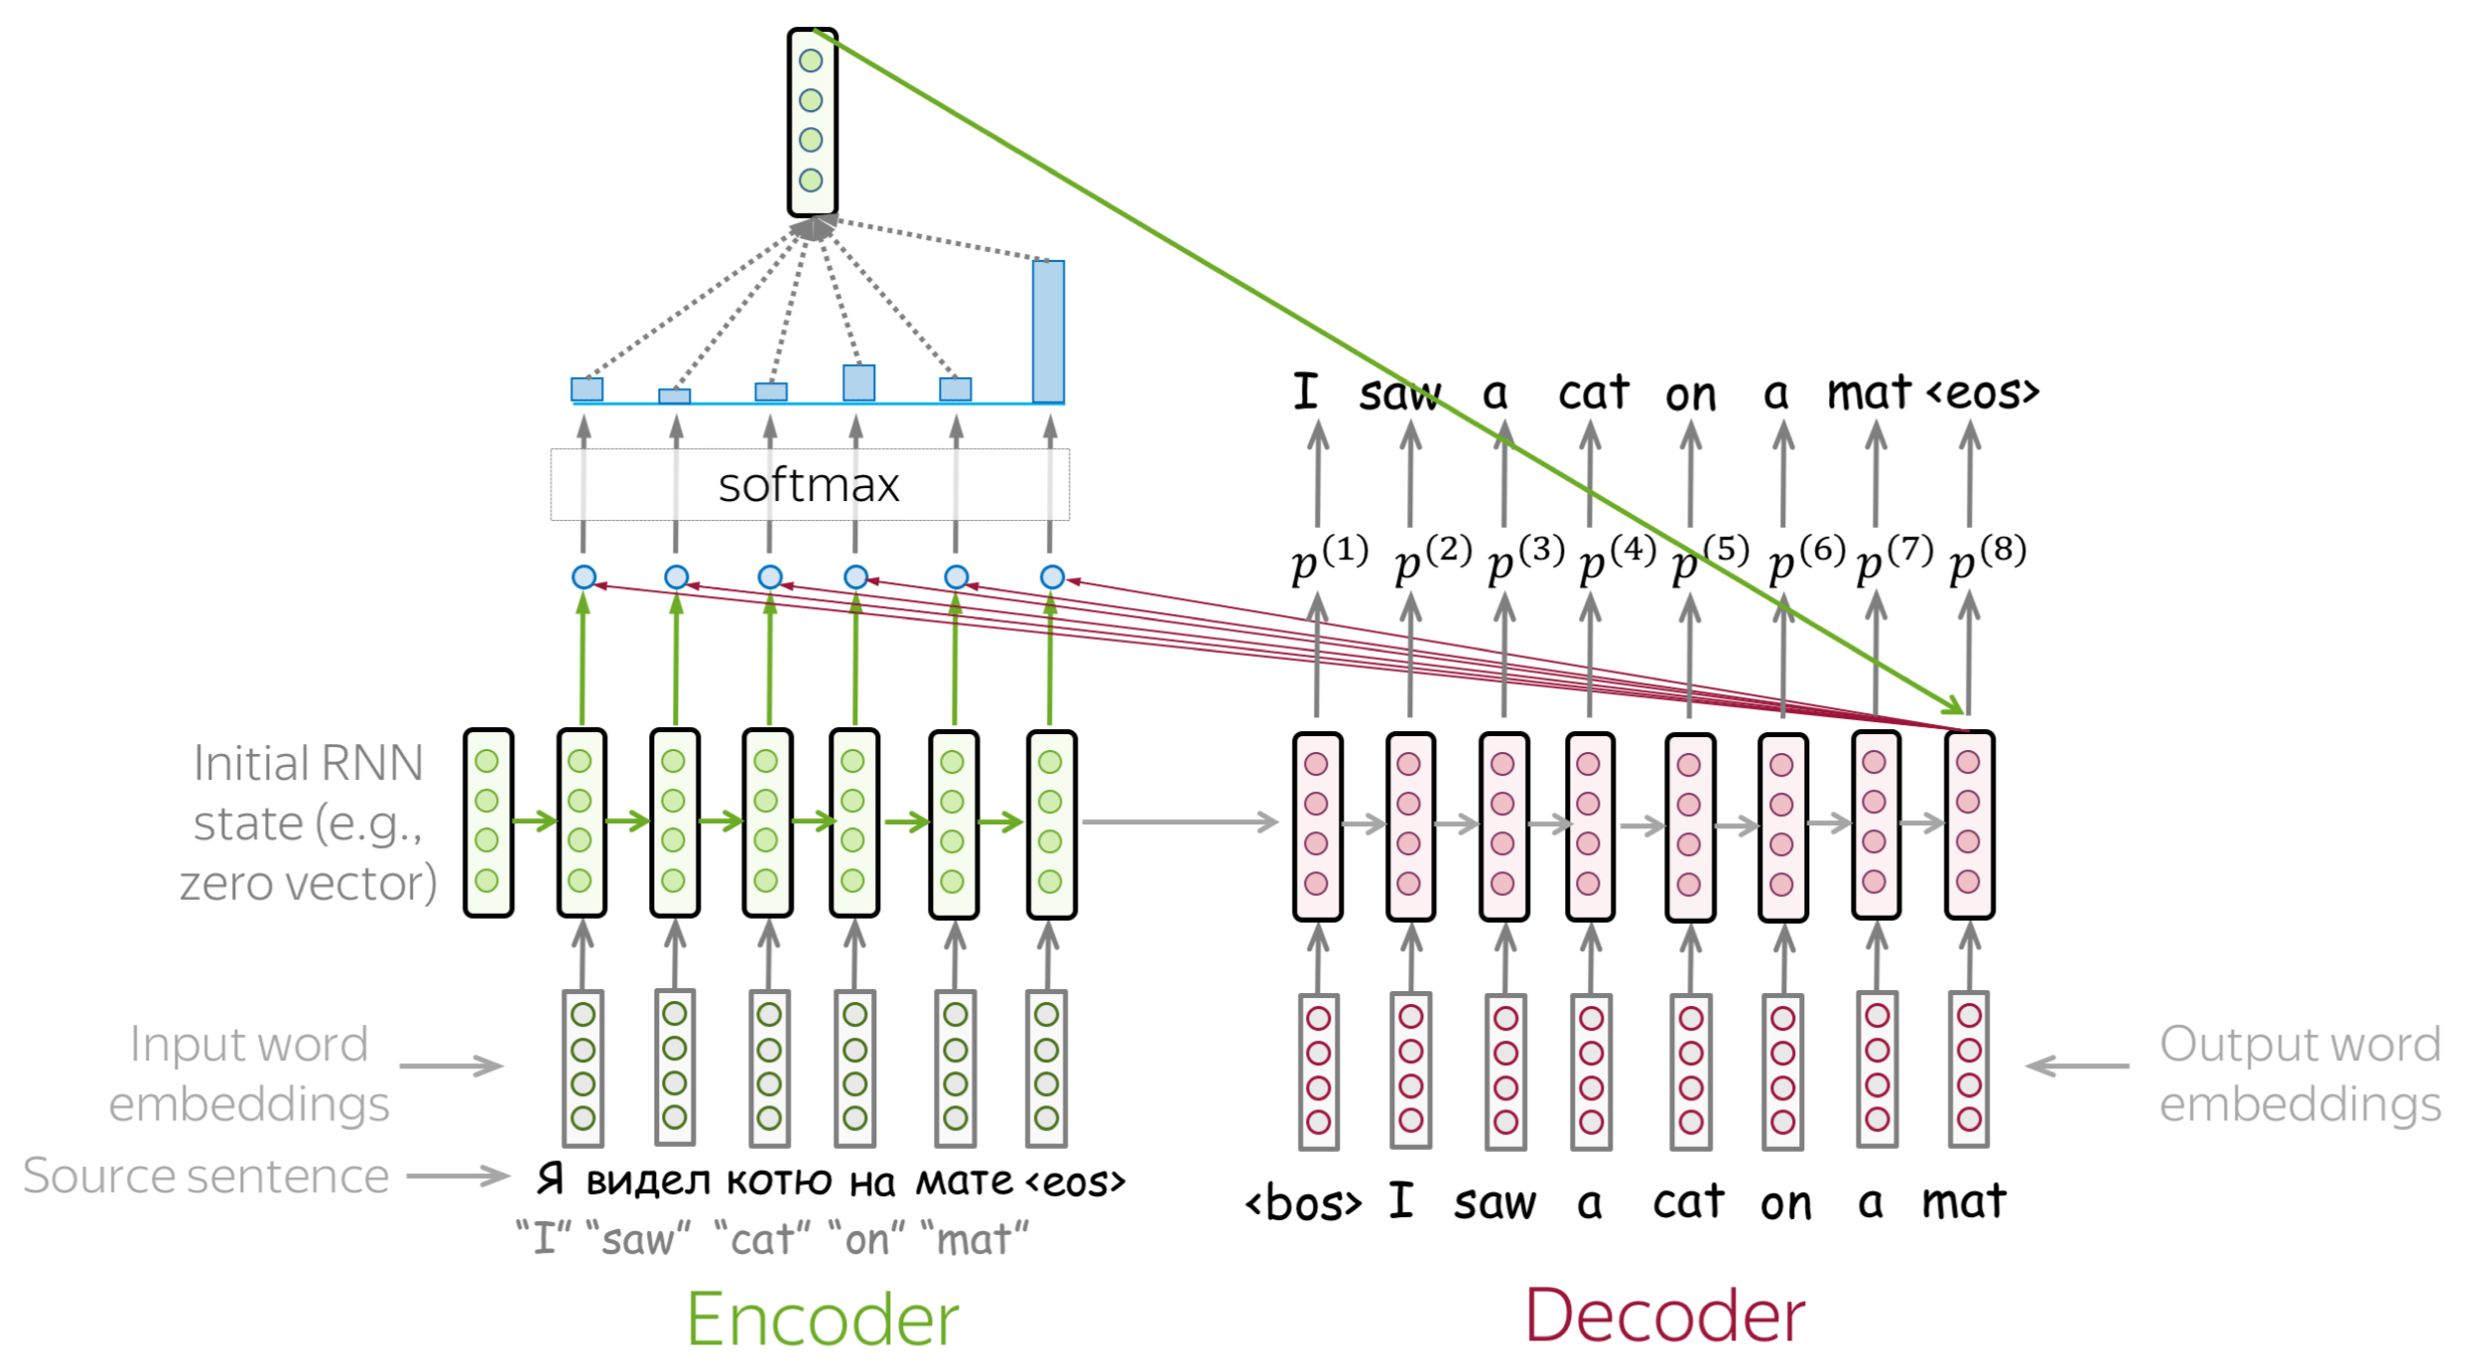
Attention

Slide 31
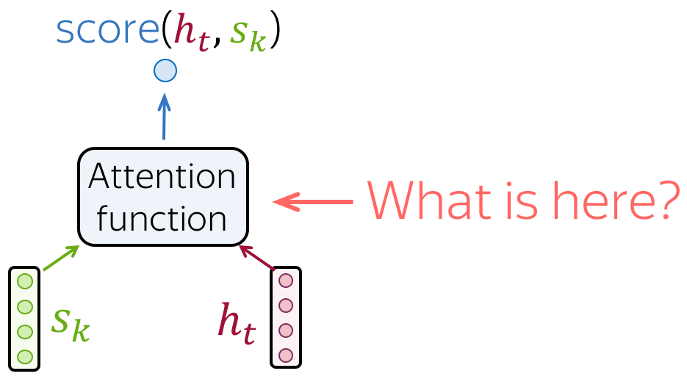
Attention. What is it?

Slide 32
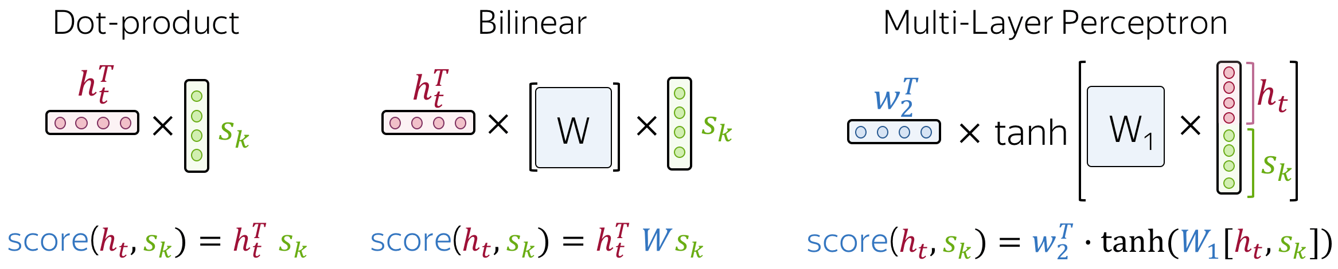
Attention. What is it?
https://arxiv.org/abs/1508.04025
https://arxiv.org/pdf/1409.0473.pdf

Slide 33
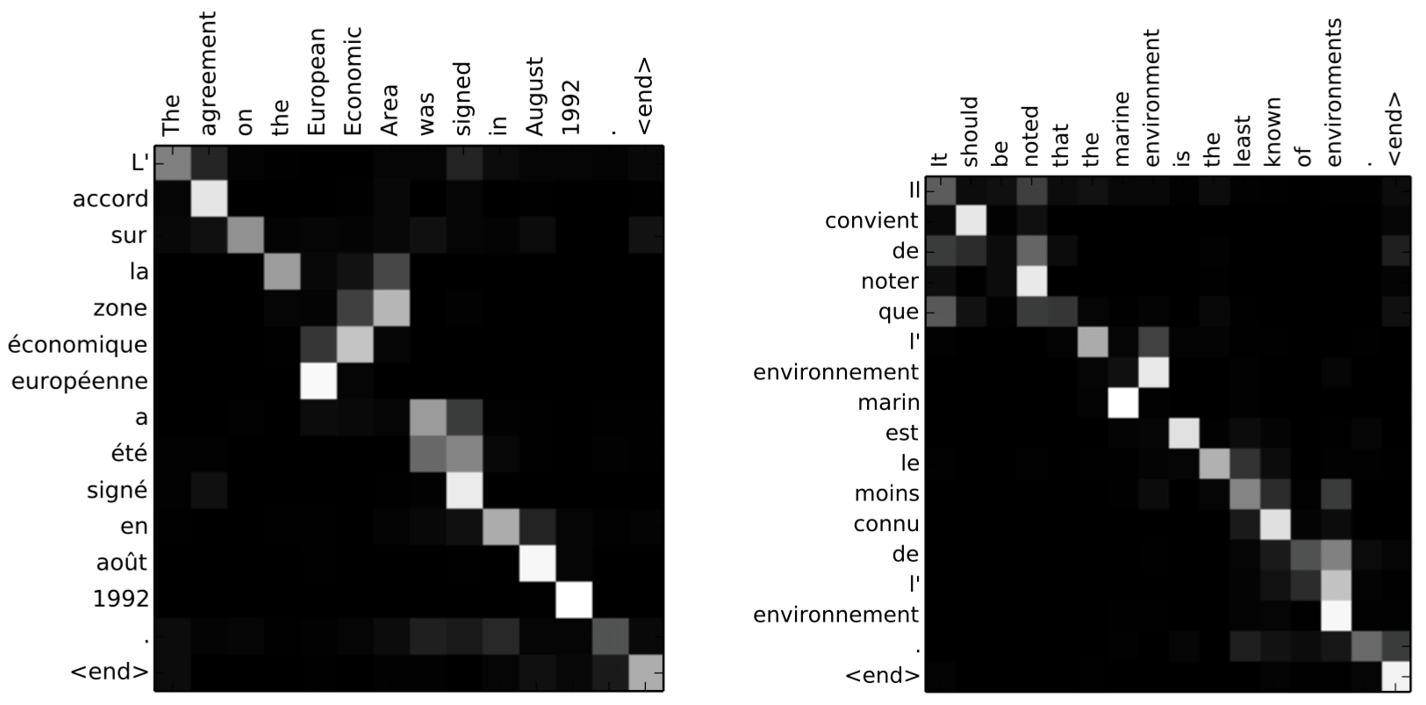
Attention

Slide 34
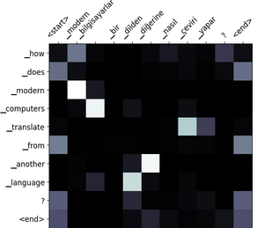
Attention

Slide 35
Architectures with Attention
1

Slide 36
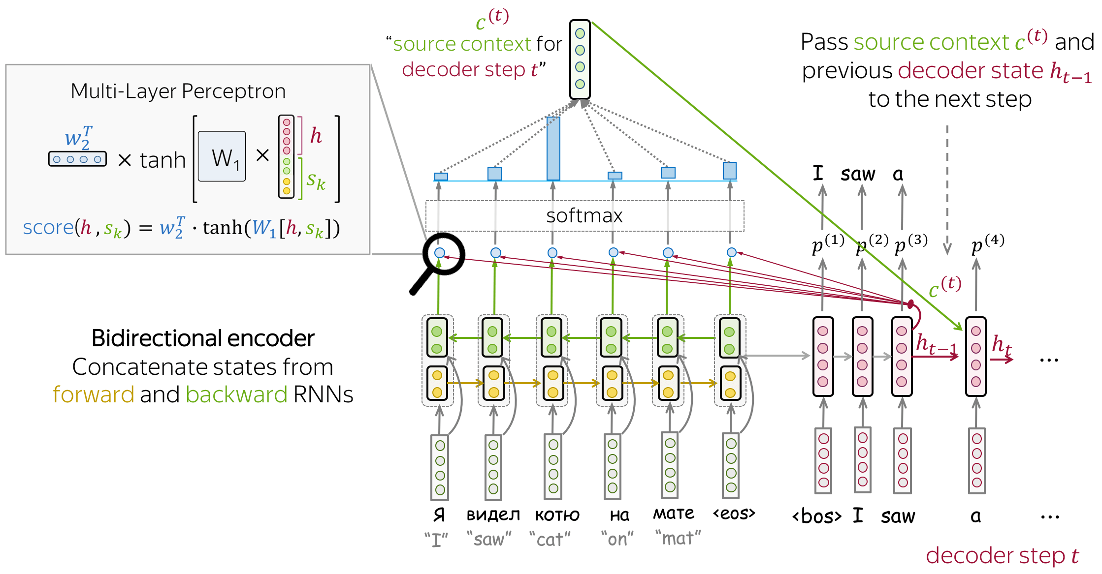
Bahdanau seq2seq

Slide 37
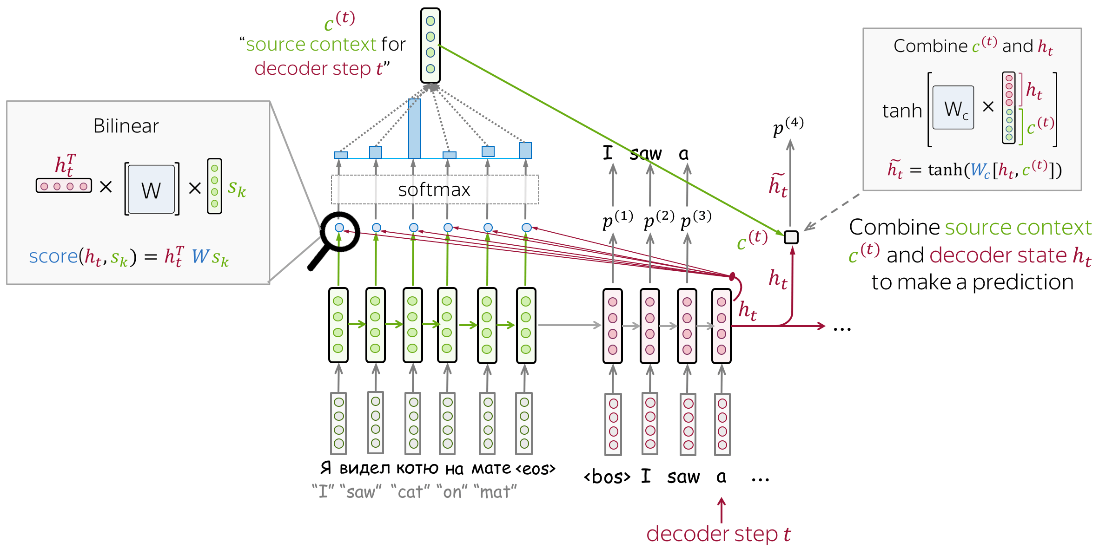
Luong seq2seq

Slide 38
Transformer
1

Slide 39
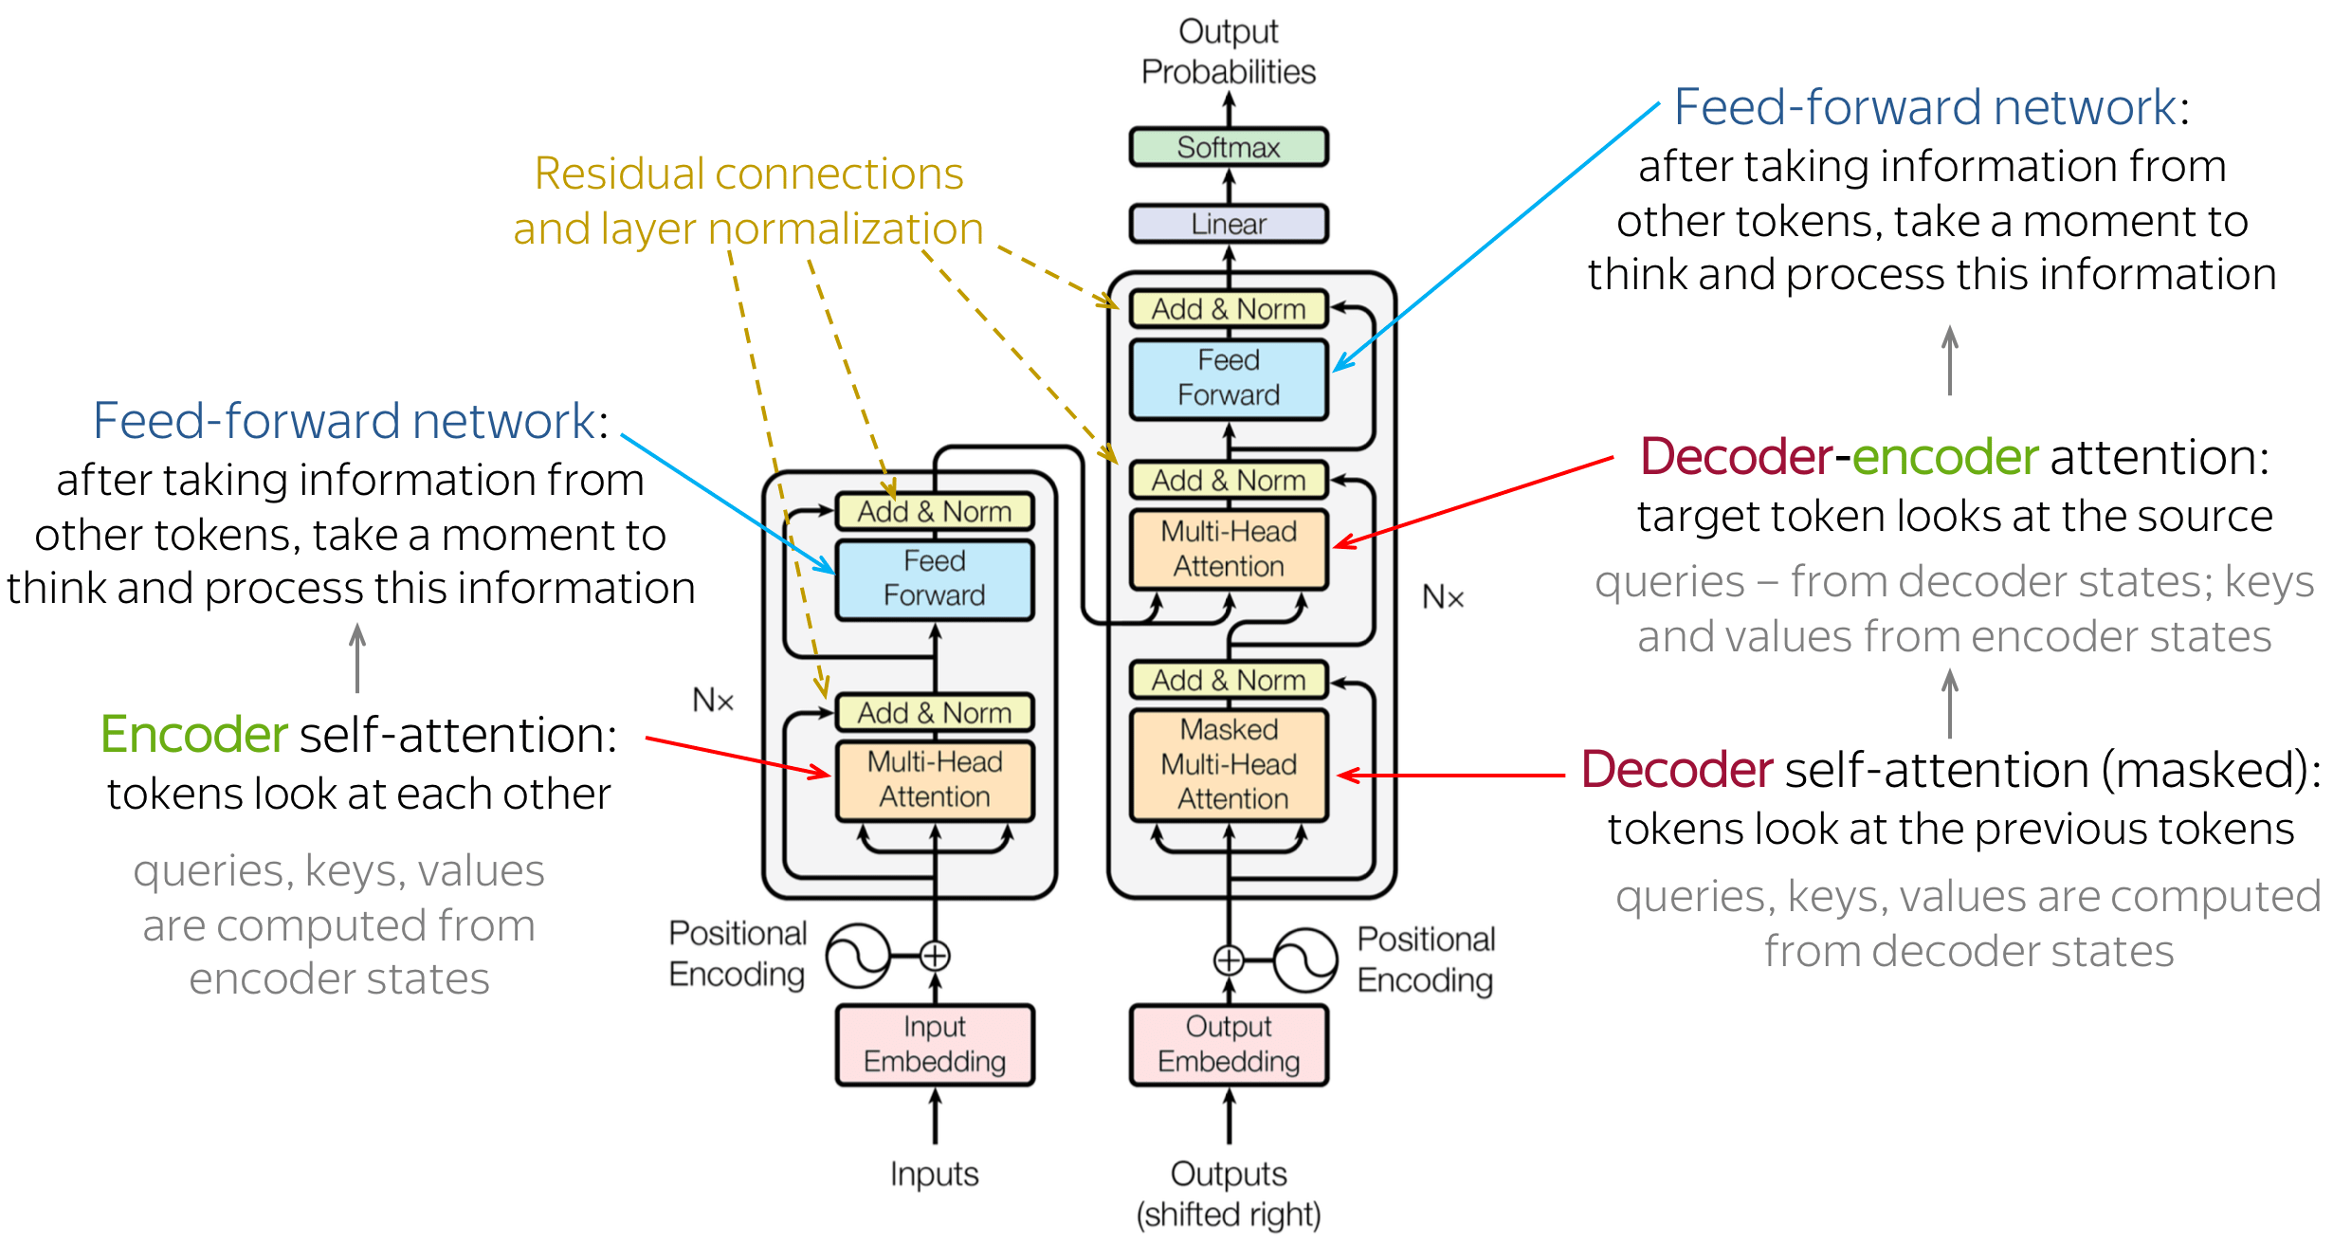
Архитектура

Slide 40
Self-Attention
1

Slide 41
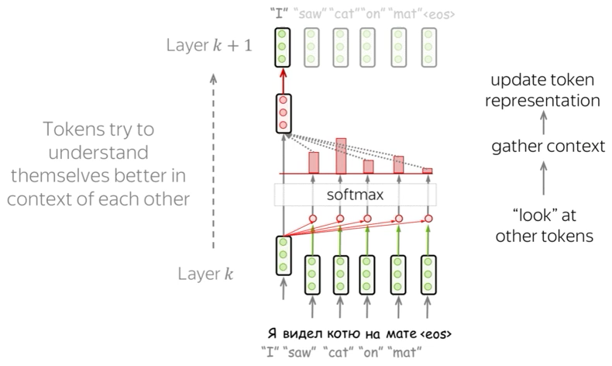
Self-Attention

Slide 42
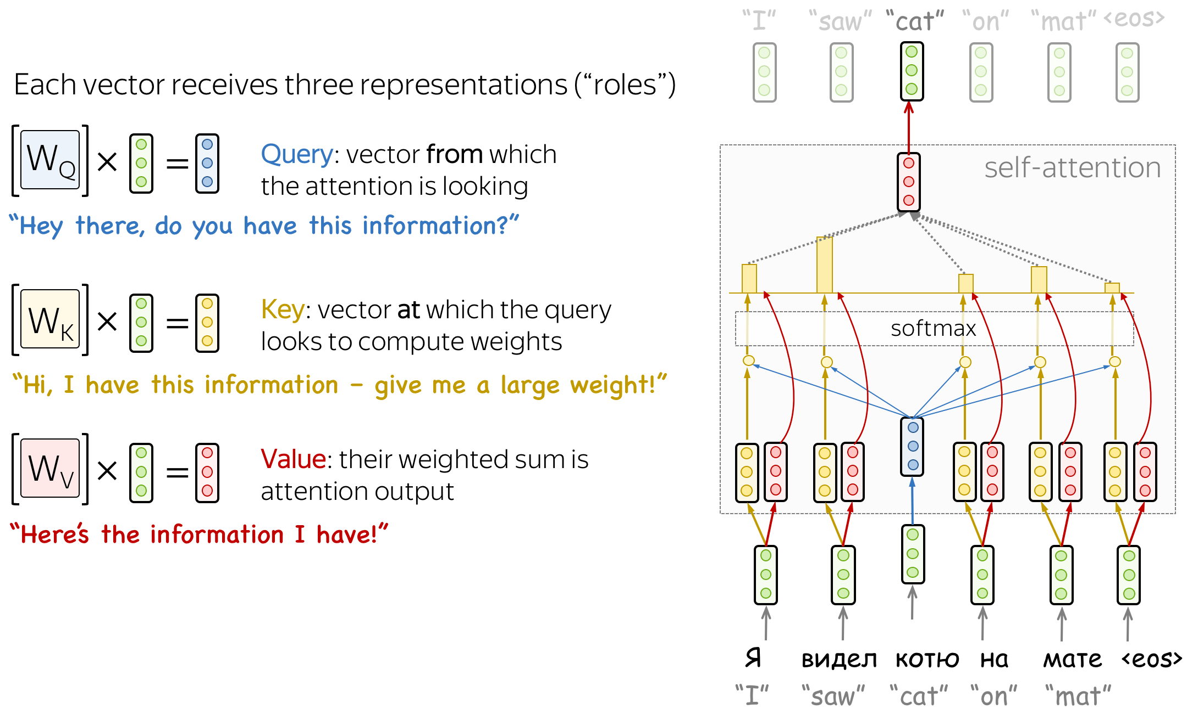
Self-Attention

Slide 43
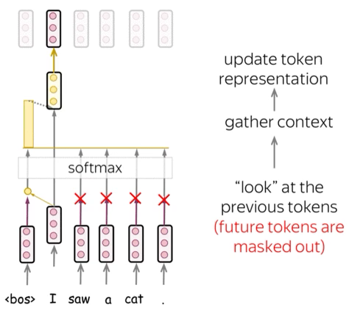
Masked Self-Attention

Slide 44
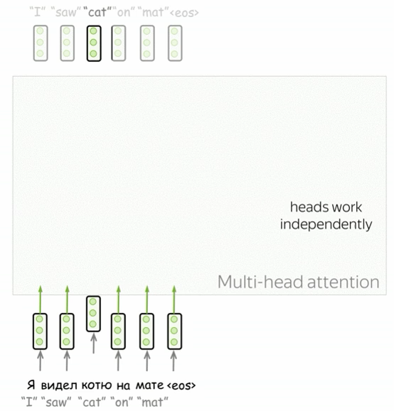
Multihead Self-Attention

Slide 45
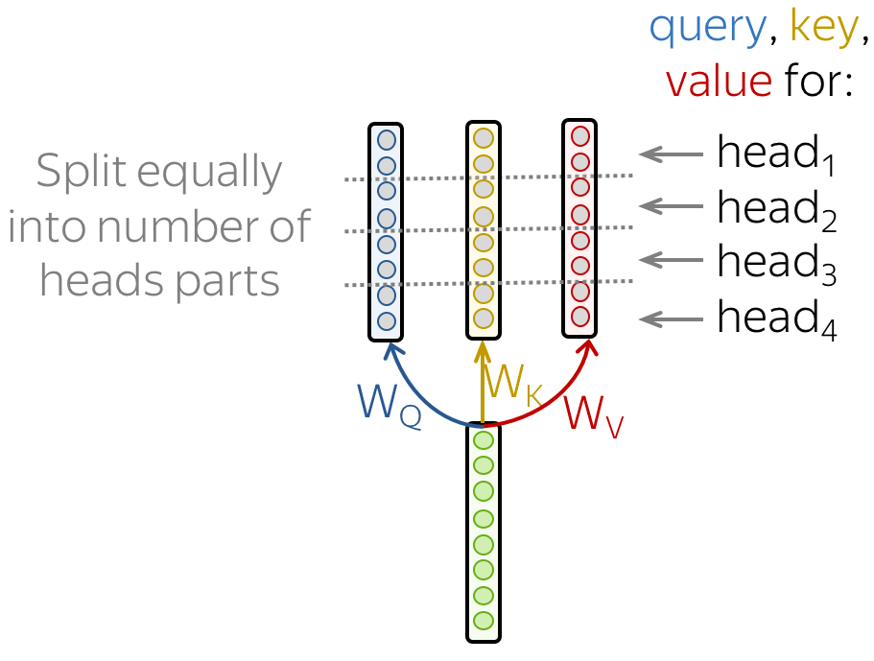
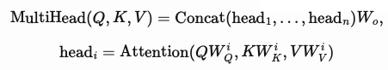
Multihead Self-Attention

Slide 46
Positional Encoding
1

Slide 47
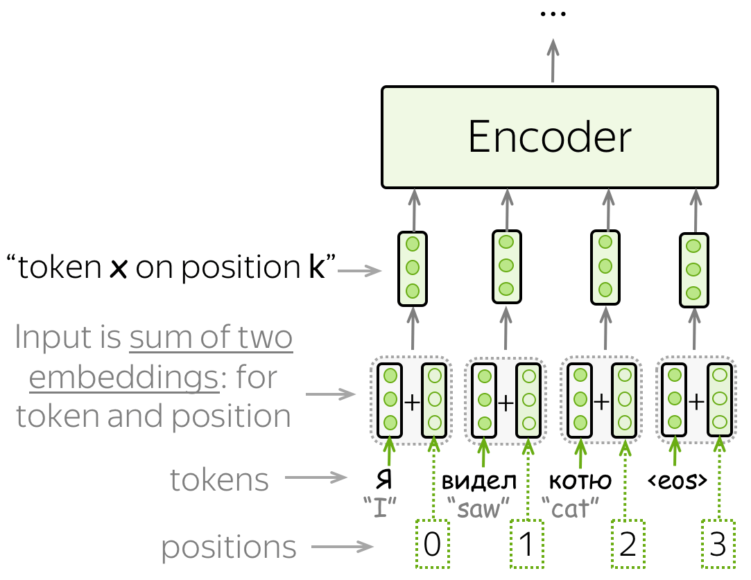
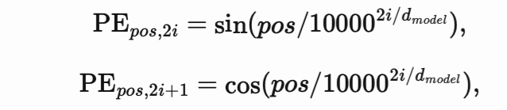
Positional Encoding

Slide 48

Positional Encoding

Slide 49
FFNet
1

Slide 50
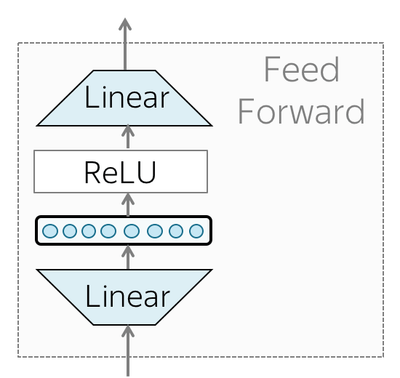
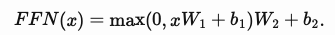
FFNet

Slide 51
BERT
1

Slide 52
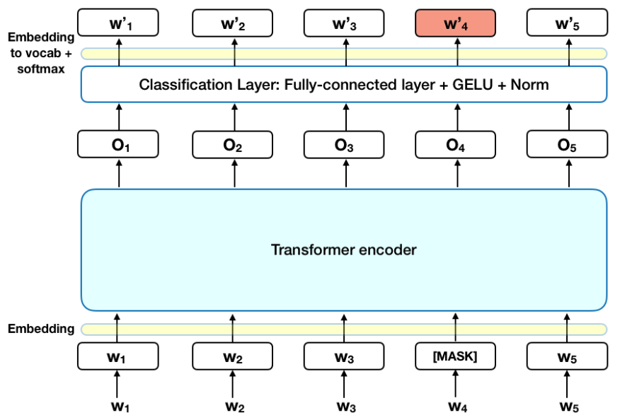
BERT

Slide 53
Спасибо за внимание!

